Slide 1
WATER, SANITATION AND HYGIENE TECHNOLOGIES (WASHTECH) PROJECT 2011 - 2013
Benedict Tuffuor
TREND
29.03.2012

Slide 2
Summary of presentation
What is WASHTech?
Rationale
The task at hand
Project Objectives
Workages
Main methods
Target group
Outputs
Where we are

Slide 3
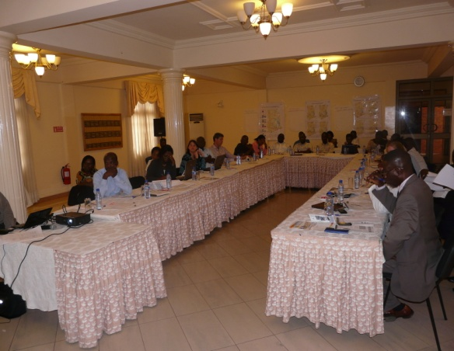
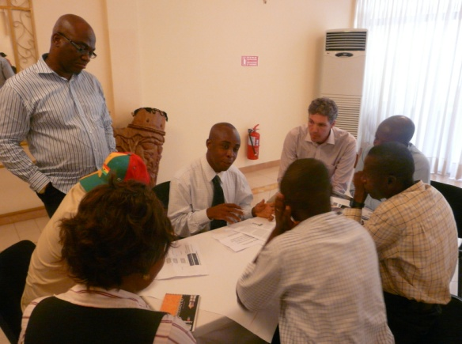
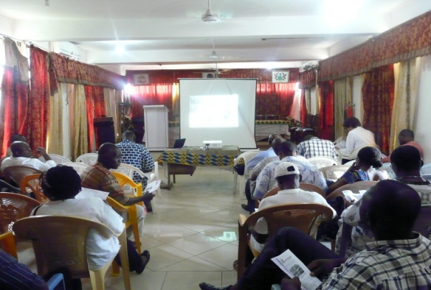
WHAT IS WASHTECH?
It is a EU funded project (FP7)
Focuses on technologies for sustainable WASH delivery in Peri-urban, Small Towns and Rural areas
Multi-Stakeholder Action Research Project involving 8 European and African partners
Three countries: Ghana, Burkina Faso and Uganda
Implementing institutions in Ghana are TREND/RCN, KNUST- DCE and WaterAid
It adopts the LA approach to ensure learning and sector uptake
It is a 3-year project

Slide 4
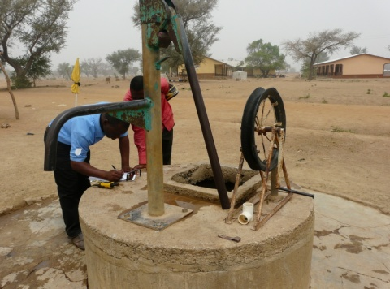
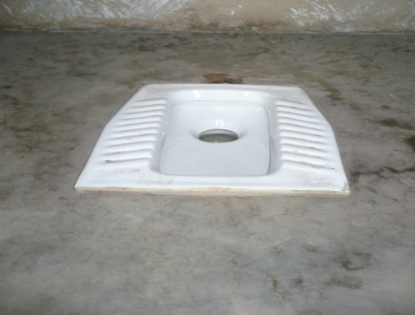
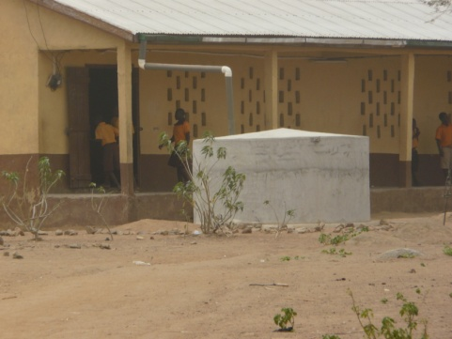
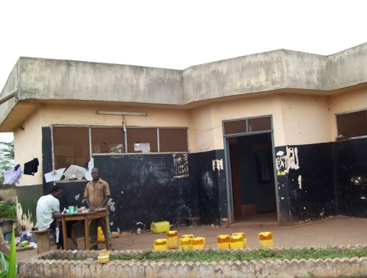
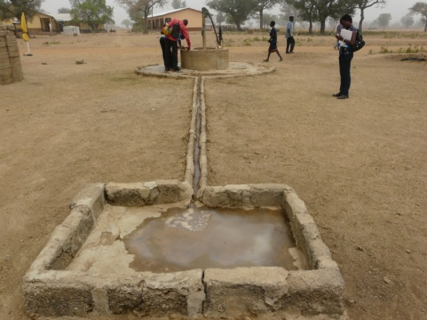
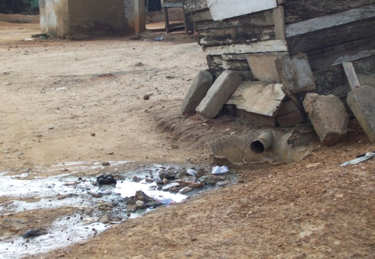
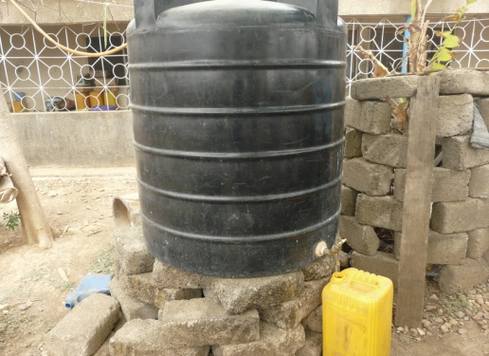
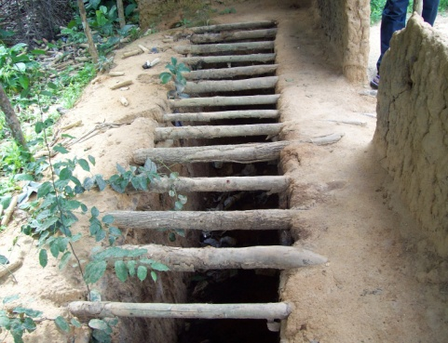
RATIONALE
Achieving water and sanitation MDGs in many African countries South of Sahara uncertain
Role of affordable, sustainable technologies recognised
Good range of innovative WASH technologies
National strategies focus on the conventional
No systems to validate new technologies and assess real potential
No proven approaches to successfully introduce and go to scale

Slide 5
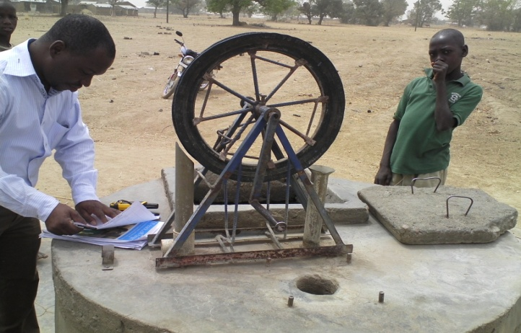
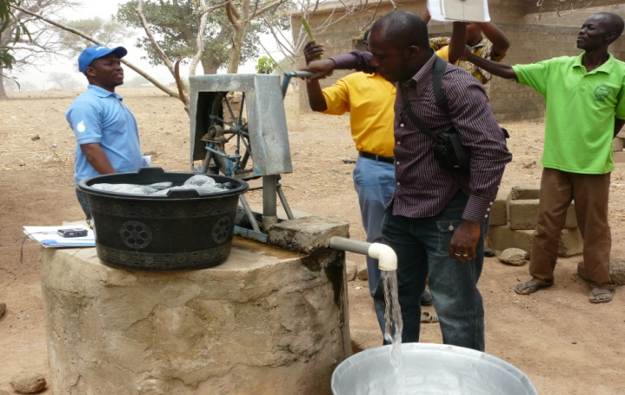
THE TASK AT HAND
To provide the sector with a systematic and participatory way of assessing and adopting technology innovation that effectively takes the poorest of the world a step closer to expanding their life choices and opportunities for development.

Slide 6
OBJECTIVES
Overall goal is to facilitate effective investments in new technologies for sustained access to WASH services
Strengthen sector capacity for informed decision in the choice of sustainable WASH technologies
An action research to identify barriers and opportunities for scaling up technology beyond pilot stage
To provide a set of methodological tools and participatory approaches for informed decision-making and strategic planning
Support the embedding of the practice of multi-stakeholder learning, sharing and collaboration

Slide 7
WORK PACKAGES
WP1 Consortium Management
WP2 Situation analysis on WASH technology introduction + uptake
WP3 Framework/ process design +development and finalisation
WP4 Pilot Technology assessments (3 countries)
WP5 Recommendations for sector strengthening
WP6 Capacity building for Learning Alliance members
WP7 M+E / Analysis of impact
WP8 Communications and information dissemination
WP9 Coordination

Slide 8
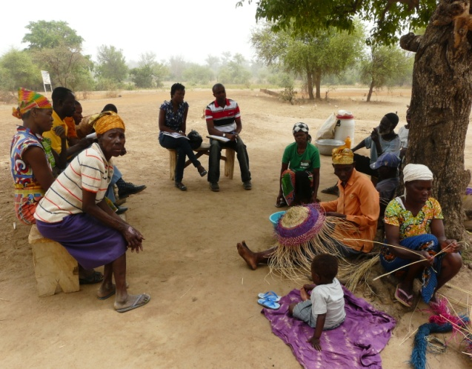
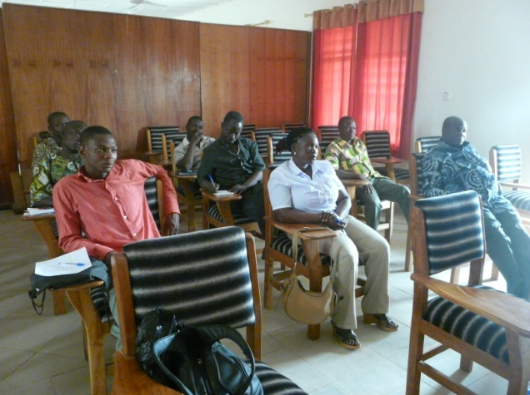
MAIN METHODS
Research and capacity building activities:
To increase awareness on technology options
Develop assessment systems
Build long-term in-country capacities

Slide 9
TARGET GROUP
National level level WASH sector stakeholders = gov’t, NGOs, SMEs
District (decentralised level) WASH stakeholders with a focus on local decision-makers, planners, practitioners
Interface between community and district level (includes community leaders and potential users)
Focus on households, rural areas, and small towns, and somehow low-income peri-urban areas

Slide 10
OUTPUTS
TECHNOLOGY ASSESSMENT FRAMEWORK (TAF)
Informative guidelines for the application and adaptation of TAF at different scales
A global TAF review report
Country situational assessment reports
A WASHTech website
A series of training course to roll out and embed the use of TAF

Slide 11
WHERE ARE WE AND HOW?
Recs for sector
Strengthening
WP5
Africa Wide
Review
WP2.1
KAP Study
WP7.1
Country Specific
Reviews
WP2.2
Learning
Alliance
WP6
Testing of TAF
WP4
Technology
Selection
WP2.3
TAF Lit Review
WP3.1
TAF Review and
Adjustment
WP3.3
TAF Design
WP3.2

Slide 12
SPECIFIC OUTPUT - GHANA
Establishment of WASHTech core group (WD, EHSD, CWSA, CONIWAS, SHEP, Private consultants, implementing partners
Country technology (selected) review report
Country KAP study on technology assessment and approval process report
Country project communication strategy
Country project flyer
Country picture of change (PoC)
Country most significant change (MSC) plan

Slide 13
Thank you!

