Slide 1
Public and Private Partnership in Achieving a Toilet in Every Home in Ghana
Mole XXIV
Building Effective Partnership for Scaling-Up Sustainable Sanitation Services in Ghana
Kweku A. Anno – Biological Filters & Composters Ltd (BIOFILCOM)
14 August, 2013

Slide 2
Definitions-PPP
Public Policy - Public Policy is “what governments choose to do or not to do” (Dye, 2002) towards the process of sustaining national development.
Private Sector Policy - Private politics on the other hand is described as “the process by which policies that have a public impact are made in and adopted by non-state actors, specifically business firms and outline how it can and should be integrated into the framework of the public policy process” (Werner, 2013).
PPP Guidelines (2011)

Slide 3
Pressing issues to look at
How are we going to fill the 39% gap before 2015
Up to 16 million Ghanaians use unsanitary or shared latrines
4.8 million have no latrines at all and defecate in the open
Ghana losses a huge sum of GHc 420 Million per annum in lost incomes from the sub-sector; huge NHIS bills as a result of the persisting unsanitary conditions.
Open defecation costs Ghana GHc 160 million per year
Yet eliminating the practice would require less than 1 million toilets to be built, used and paid for in 4 years.

Slide 4
Scope of Partnership
Public
Private
Expanded Partnership
Public
Private
Academia/Science & Technology
Civil Society/Development Partners
Media
Beneficiaries/Communities

Slide 5
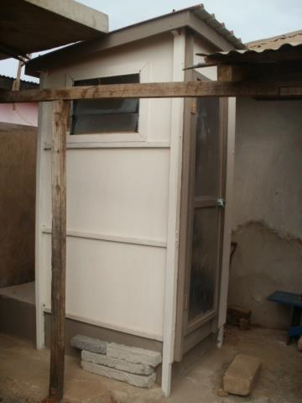
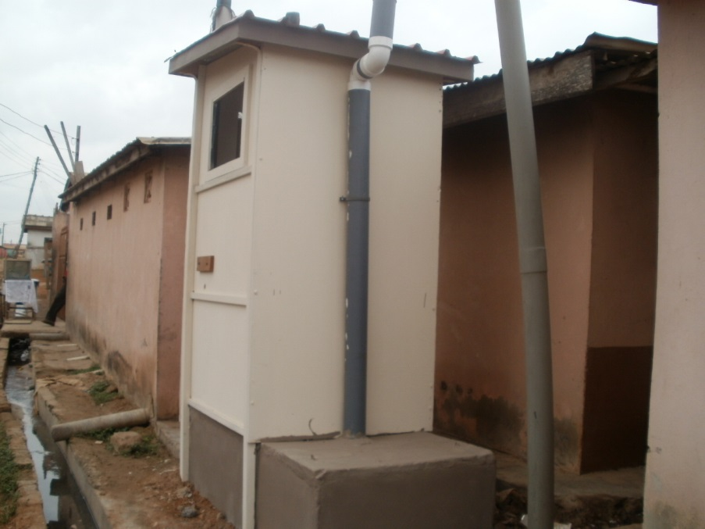
Solution by BIOFILCOM - Biofil Toilet
BIOFILCOM through Ghanaian innovation has provided a technical solution in the Biofil toilet
In scaling-up to meet the sanitation gap, there is the need to have an expanded partnership

Slide 6
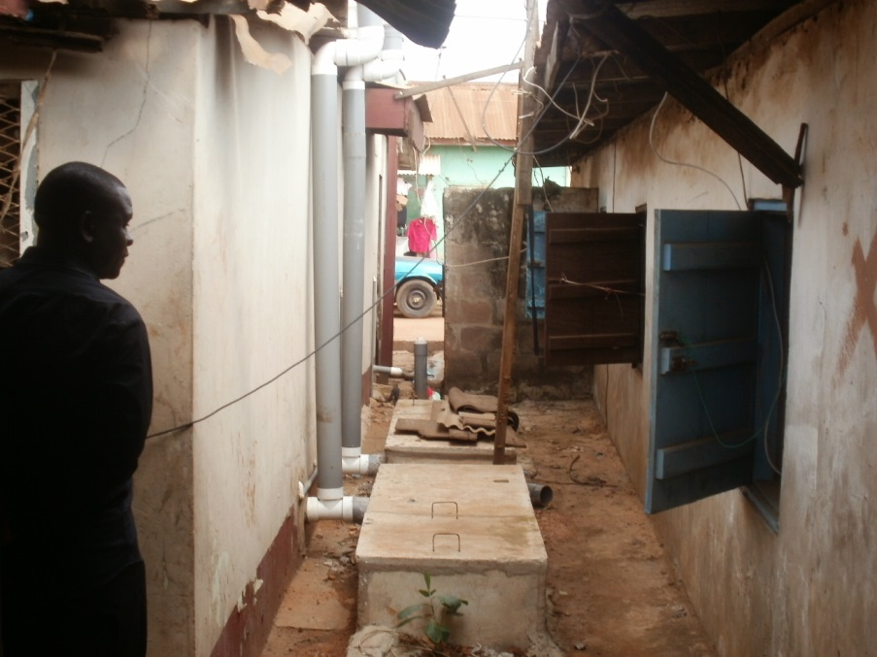
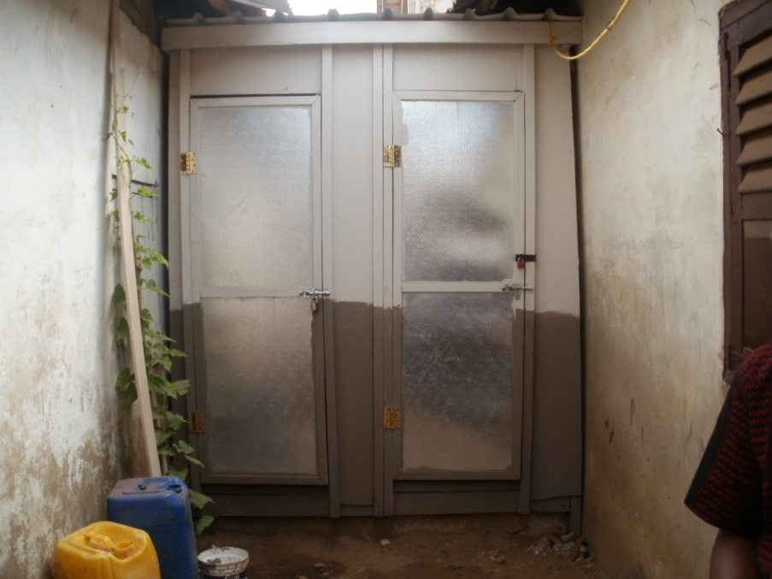
Fits in tight corners

Slide 7
Challenges of Financing
Microfinance institutions are available to finance HHs to own toilets however there is the risk of high defaulters in users repayment.
Clearly that presents the missing link

Slide 8
PPP is the way to go
Government (MMDAs) MUST team up with Private Sector to implement the “toilet in every home” policy while they payback through the sustainable Property Rate System
How - Role of Public Sector (PuS)
PuS establishes sanitation escrow accounts at MMDAs with seed money as a revolving fund and act as a guarantor for the scheme to be repaid within the set times of the investment.
PuS (government/MMDAs) should enforce payment by legislation.
PuS mobilizes beneficiaries (i.e. Landlords) by georeferencing their locations.

Slide 9
PPP is the way to go – Cont’d
How - Role of Private Sector (PrS)
PrS (i.e. BIOFILCOM, NGOs, MFIs) access funds from escrow account through a PPP arrangement to provide HH toilets/services to beneficiaries in planned locations based on data from PuS.
Innovative technologies (Biofil toilet)

Slide 10
PPP is the way to go-Cont’d
End User/Beneficiaries
Pays back through Property Rates
Owns a “decent” toilet

Slide 11
Opportunities for funding Scheme
GoG budgetary allocations to sanitation escrow accounts
Donor contributions to sanitation escrow accounts
MMDA contributions to sanitation escrow accounts
Repayments by beneficiaries/households via property rates

Slide 12
Opportunities for funding Scheme-HH Repayment
Ability to pay
Those who use unsanitary and shared latrines pay between10 to 50 Ghana Pesewas
Biofil toilets can be repaid within 5 years for the proportion paying 10 Pesewas and 1 year for those paying 50 Pesewas.

Slide 13
Conclusion
Consensus for a new PPP
Expand the need for PPP
Government needs to guarantee schemes/funds for the Private Sector to operate effectively to meet the MDG goal for sanitation.
Ghana stands to gain even 50% of its lost income if it GoG supports and guarantees the private sector players in sanitation through a PPP arrangement.
Every home can own a toilet, investments would be paid for and the income thereafter is re-invested to enable the country reach a high target of over 80% sanitation coverage by 2025.

