Slide 1
HUMAN RESOURCE CAPACITY
GAP ASSESSMENT STUDY
RCN/KNUST Department of Civil Engineering

Slide 2
Presentation outline
Study background and objectives
Workshop objectives
Water and Sanitation Coverage
Institutional structure and HR in the WASH sector
Assessment Methodology
Capacity building framework

Slide 3
Background
The constraints in getting the required number of staff and competence to meet the MDGs and to sustain services are not certain,
The IWA in collaboration with Cap-Net is supporting WASH Sector Human Resource Capacity Gap Assessment,

Slide 4
WASH HR Workshop Objectives
To present the purpose of the study to stakeholders and seek their inputs and guidance,
To discuss the study methodology and key partners to review work and make inputs,
To plan follow up meeting for verification of findings and presentation of final report
To plan for Human Resources Development (HRD) Plan or capacity building in WASH Sector.

Slide 5
Study Objectives
The objective of the study is:
To assess the demand for WASH HRs in Ghana to meet MDGs.
To assess supply of HRs and the competences (skills and knowledge) being made available to the sector
To propose capacity development recommendations to meet demand for qualified personnel in the short and medium term,

Slide 6
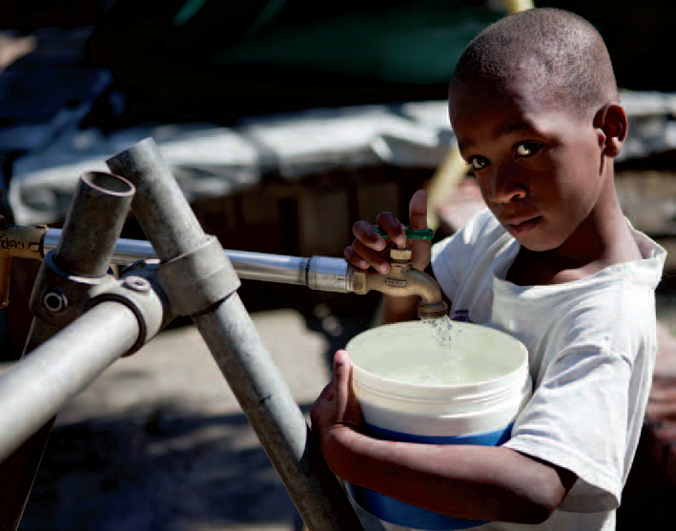
Water Coverage
Access to improved drinking water in 2010 (%)
Urban | 91
Rural | 80
National | 86
National Target | 85
MDG target | 80

Slide 7
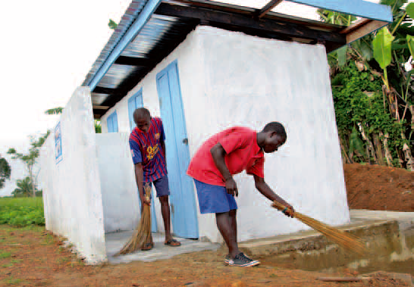
Sanitation Coverage
Access to improved sanitation in 2010 (%)
Urban | 19
Rural | 8
National | 14
National Target | 54
MDG target | 52

Slide 8
HR capacity in the WASH sector
Sub-Sector | Staff strength | Additional demand
Urban water (GWCL/GUWCL) | 3,162 (2010) | ?
Rural water (CWSA) | 211 (2012) | 29
Urban/rural sanitation (MMDAs) | 2,236 (1999) 2,743 (2009) | 4,077 (110 MMDAs)

Slide 9
Institutional structure and HR in the WASH sector
Role | Ministry | Gov’t Agency | Private sector
Policy and planning | MLGRD (LGS, EHSD) MWRWH (Water Directorate)
Facilitation & regulation |  | WRC, CWSA, PURC, MMDAs
Service delivery |  | MMDAs, GWUL, GWCL, Watsans | Private companies, NGOs,
service demand | Rural and urban towns

Slide 10
Study Methodology
Task 1 Desk study on Service Coverage per JMP
Task 2 Existing human resource capacity in the WASH sector
Number of employees,
Competence and qualifications
Drivers & incentives
Task 3 Estimating current and future HR demand per coverage to meet MGD
Task 4 Current and future Supply of HR
qualification and skills
Incentives for supply
Task 5 Assessing the HR shortage and capacity gaps
Task 6 Additional HR required, strategy and short to medium term action plan

Slide 11
Task 1 Service Coverage
Coverage | HR required
Use the MDG coverage according to JMP and full coverage deficit | HR required to meet the MDG is determined using HR proxy per 10000
Estimate future population in different types of settlements to meet coverage.

Slide 12
Task 2 Existing HR capacity and competencies
Categories of organisation | Competence
Quantify total number of organizations | Quantify categories of competences (qualifications and years of experience)
Use sample of organizations from each category, and employees per each category of organisations | Determine total country wide existing HR and competence

Slide 13
Task 3: HR Demand
Standards | Demand
HR proxy (standard) for a defined categories of service delivery in urban and rural areas required to: a) design for 10000 people /year. b) construct for 10000 people /year. c) operate and maintain services for 10000 people per year. d) Community mobilisation, | Estimate the current and future HR demand in order to achieve MDGs/ full coverage
Service types: Urban water, Urban sanitation Rural water and sanitation | Use the existing watsan coverage types and HR proxy

Slide 14
Task 4 Estimate HR supply
Categories of organisation | Supply
Quantify the number of staff entering the WASH sector in different disciplines. | Estimate the current and future HR supply in order to achieve MDGs/ full coverage.
Identify Level of qualifications

Slide 15
Task 5: Assessing shortage and capacity gaps
Shortage of staff | Capacity gaps (qualification gaps)
Shortage of staff per sub-sector (Shortage is the difference between the estimated demand and supply) | Identify the capacity gaps in existing HR qualifications and skills as compared to the competence required by the job.

Slide 16
Task 6: HR Development Plan
Capacity development plan | Strategies
Additional supply from HR training institutions or alternative ways to meet the shortages | Strategies and action plans for WASH HR capacity building in Ghana

Slide 17
Capacity building framework (Discussions)
What are the Gaps in demand and supply of WASH HRs?
What are the barriers to be removed and institutional arrangements?
What are the strategies for capacity building? What should be the structure/framework for linking demand and supply?
What are the resources required for HRs? What are the source of funding for capacity building?
What should be the role and support of Government for the capacity building?

Slide 18
Capacity building framework (Discussions)
What are the Gaps in demand and supply of WASH HRs?
What are the barriers to be removed and institutional arrangements?
What are the resources required for demand and supply of HRs?
What are the strategies for capacity building?
What should be the structure/framework for linking demand and supply?
What new programmes and qualifications are needed, and for what level or job category?
What are the source of funding for capacity building?
What should the role and support of Government for the capacity building?

Slide 19
Thank You

Slide 20
Discussions and Questions

