Slide 1
SNV’s WASH Financing Approach
Catalysing WASH: from Possible to Profitable (P2P Project)

Slide 2
Presentation Outline
Project Background [SNV’s WASH Financing Approach].
Why the P2P Project
Project Objectives and Key Outcomes
Target Beneficiaries
Unique Features
Fund Structure
Purpose of the Business Academy and Development Support
Role of Collaborators

Slide 3
Background
The P2P Project is a hybrid of the regular socially inclined project and regular commercial facility with emphasis on commercial.
The goal of the P2P Project is to increase access to WASH services at the household level in Ghana by scaling up access to finance and technical assistance for micro, small and medium enterprises and households/house owners.

Slide 4
Background
CATALYSING WASH: from Possible to Profitable (P2P) Project is a five year project [2015 – 2019] funded by The Embassy of the Kingdom of Netherlands (EKN) Ghana which is directly implemented by SNV in Partnership with Fidelity Bank.
The project is to stimulate private sector involvement and financing at both micro and macro levels to ensure sustainability for WASH investments and services [Strengthening the Supply side].

Slide 5
Why P2P?
The difficulty of MSMEs in the WASH Sector and households in accessing funds from Financial Institutions to scale-up and acquire WASH facilities due to;
Lack of good governance structures and adequate technical knowledge
High interest rates and collateral requirements.
The De-linked demand and supply chain of sanitation [NGOs creates demand however the supply bits have been lacking].

Slide 6
Project Objectives & Outcomes
OBJECTIVE 1: Improved Sustainability and Viability of WASH MSMEs
Outcome 1.1: MSME Capacity in Business planning, financial management and operational efficiency enhanced.
Capacity Enhancement
Outcome 1.2: SME growth, marketing and promotional capacity enhanced
OBJECTIVE 2: Increased access to finance for households and WASH MSMEs
Outcome 2.1: Appropriate lending products available for Urban WASH sectors MSMEs by segment and size
WASH Financing
Outcome 2.2: Appropriate lending products available for households by income segments
Outcome 2.3: MSMEs and Households reached through proactive communication strategy (Awareness of P2P among households, MSMEs and MFIs created)
Demand creation through awareness creation.
Outcome 2.4: Revolving loan fund operational

Slide 7
Project’s Target Beneficiaries
MFIs
WASH SMEs
WASH Micro Businesses
Households

Slide 8
Unique Features
Interest Rates
Outreach (Reach plus target)
Business Development & Nurturing through Academy with BDS support [for a period of 1 year]

Slide 9
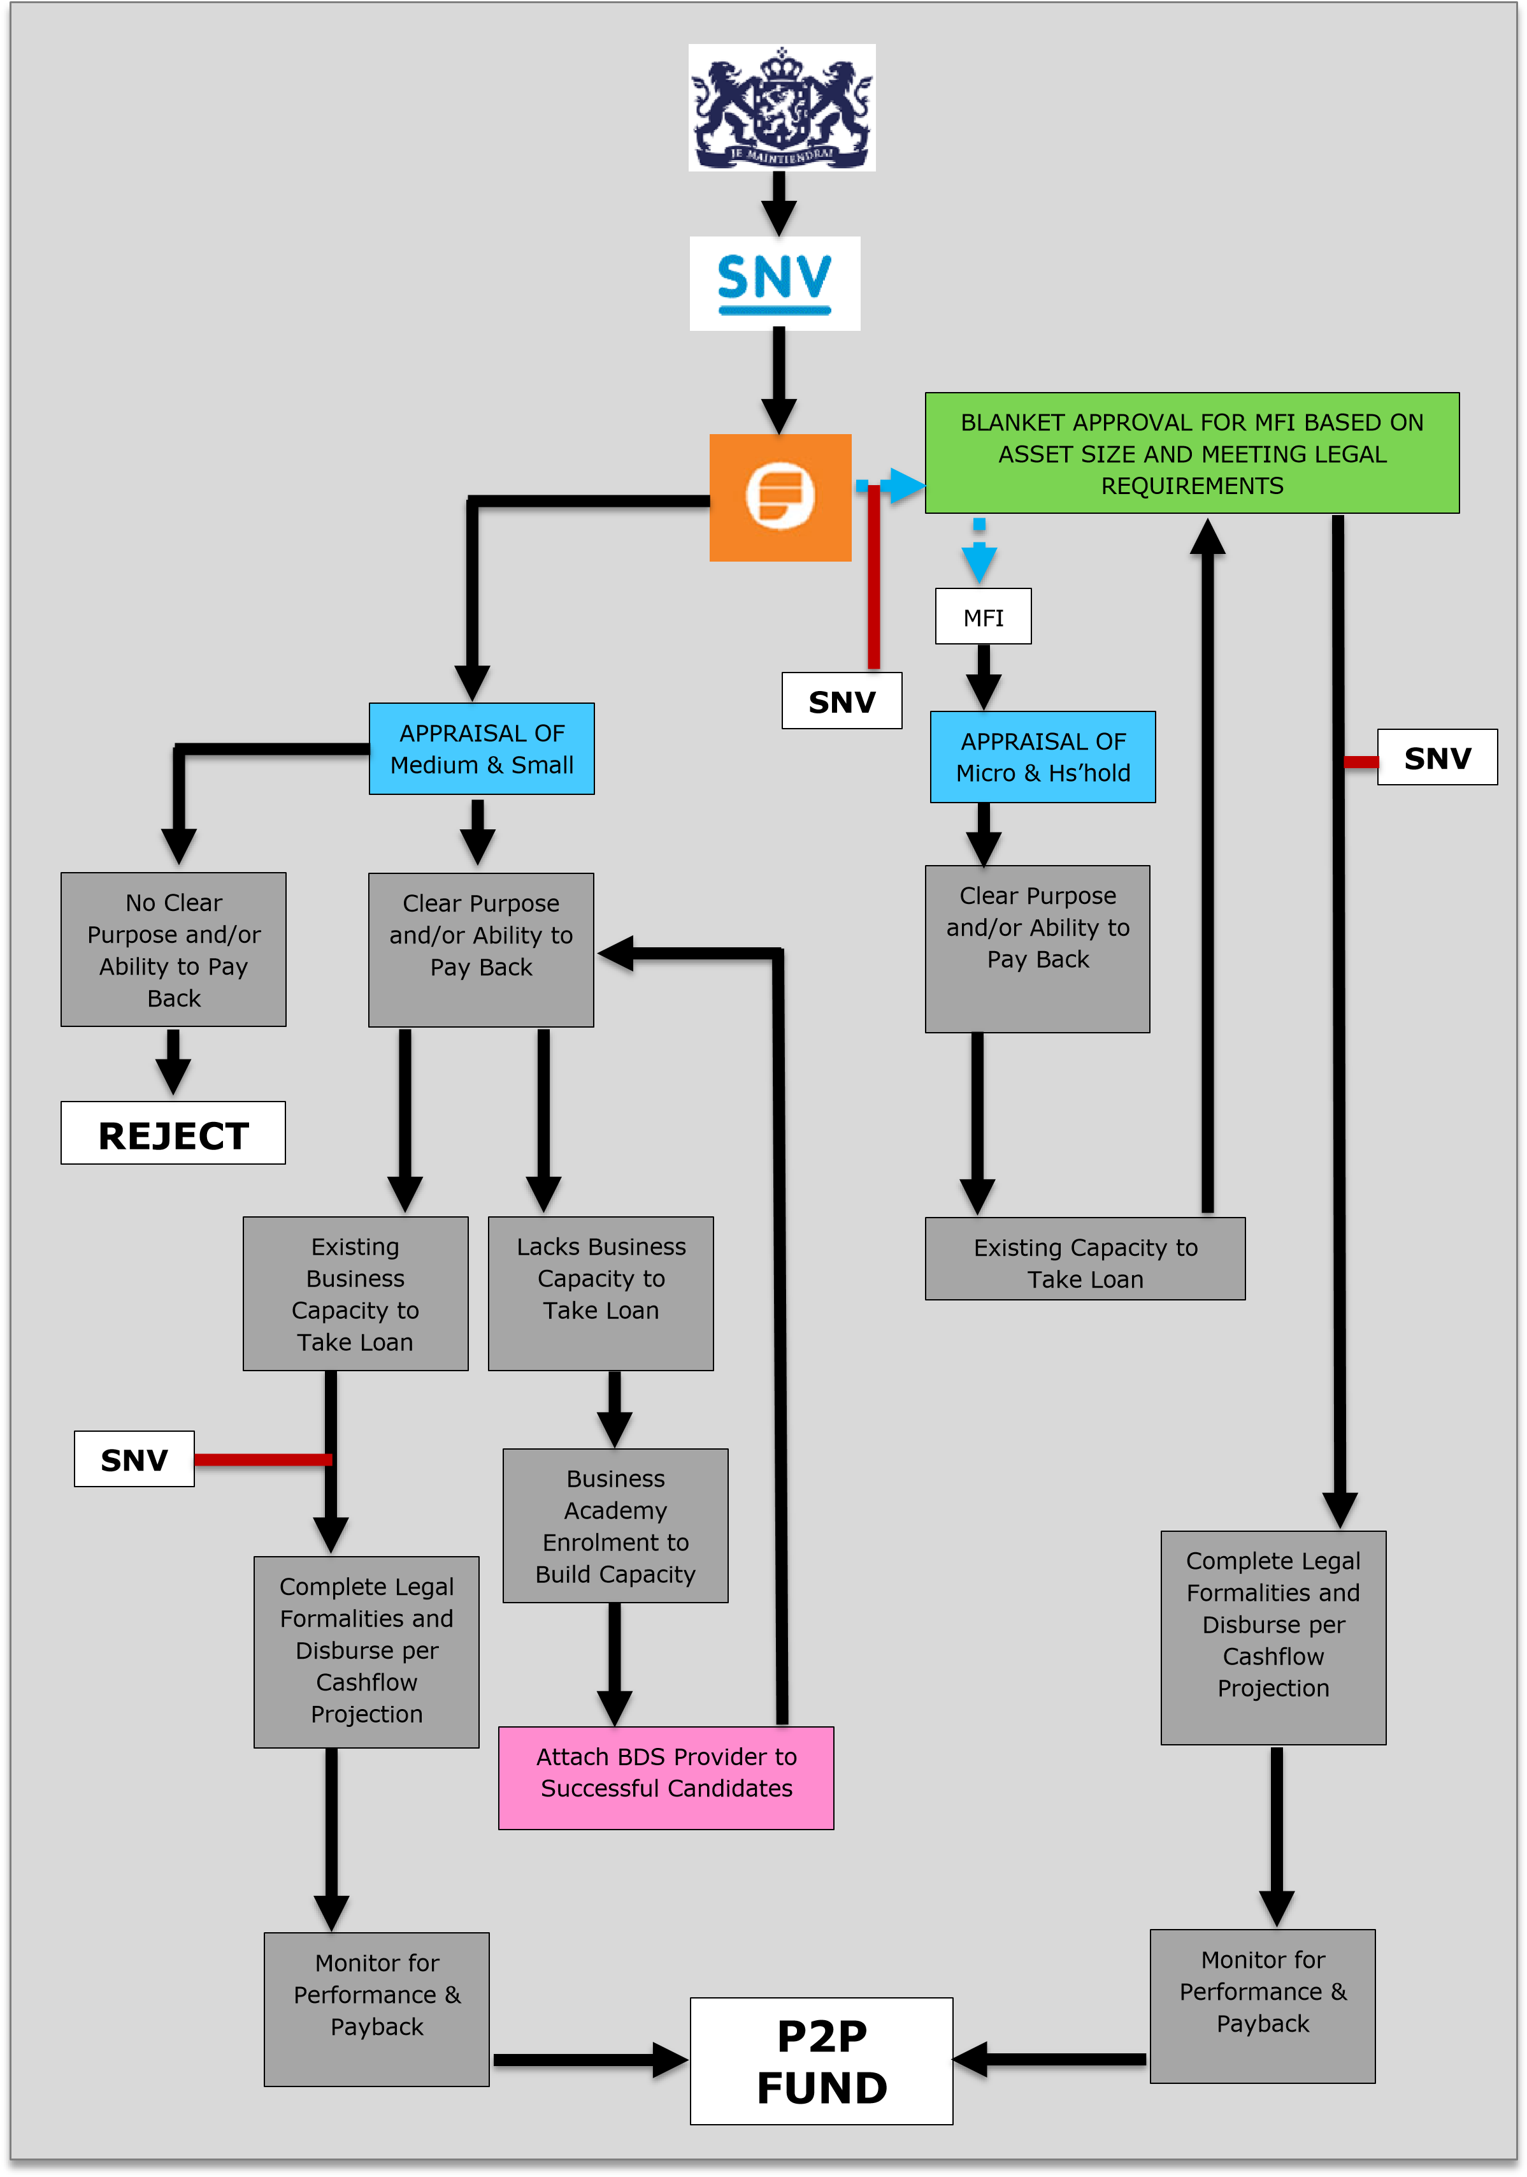
P2P Fund Structure
Fidelity Bank serves as the
Fund Manager and Custodian
Fidelity Bank will on-lend to
SMEs [10% p.a]
and MFIs [10% p.a].
MFIs will also on-lend to
Micro businesses [17% p.a]
and Households [17%].

Slide 10
Purpose of Academy & BDS Providers
Academy & BDS Provider
MSME Before
MSME After

Slide 11
Household WASH Needs P2P will Finance
Water
Borehole Drilling
Borehole Mechanisation
Pipe Connection
Household Plumbing
works.
Protected hand dug well.
etc
Sanitation
[Solid & Liquid Waste]
Household waste bin
Construction of household
improved latrine
Construction of Sceptic tank
Desludging of liquid waste
etc
Hygiene
Household bath
Pest control and
fumigation
Household soak away
Handwashing facility
etc

Slide 12
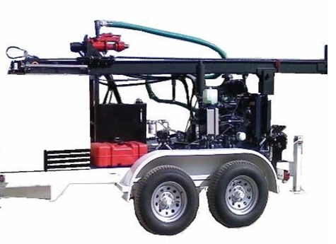
Targeted WASH MSMEs
Water
Borehole Drilling Company
Borehole Mechanisation
Pipe Connection service
provider
Plumbing service provider
Borehole hand pump
Spare Parts Dealer.
Local Water Vendor
Area Pump Mechanic
etc
Sanitation
[Solid & Liquid Waste]
Household waste bin
Operator of Public Toilet
Latrine Construction Artisans
/companies
Desludging Services
Recycling Companies
[Waste Utilisation]
Solid waste collection
companies
Motorking Waste Solid
collection
Provider of Mobile toilets
Hygiene
Cleaning Services
Pest control and
fumigation Services
Operator of Public Bath
Laundry Services

Slide 13
Role of Collaborators [NGOs and CBOs]
NGOs/CBOs
Demand Creation
MFIs
Artisans
Households

Slide 14
Other WASH Financing Approach
Unlike traditional way of funding where NGOs/agencies are provided with upfront funding, SNV now uses an approach that ensures that agreed deliverables are delivered by these bodies and independently verified before payments are done.
Results-Based Financing for Sustainable Sanitation and Hygiene (RBF4SSH) is funded by The Japan Social Development Fund (JSDF).
The Project is implemented in 4 Districts of Northern Region [Tamale, East Gonja, West Gonja and Saboba].
Sustainable Sanitation and hygiene for all
Central, Northern, Volta and Upper West

Slide 15
Partners
APDO
Center for Development community initiative (CDCI)
Savanah Integrated Rural Development Aid (SIRDA)
BIDO
MMDAs (EHA)

Slide 16
Pitfalls to Avoid
To ensure a smooth take off with the P2P project work with the banking sector particularly to ensure adequate understanding and acceptance to use their lending platform to scale the viability of WASH business, SNV engaged MFCs to have a shared appreciation of our respective mutual benefit
Need to obtain deeper insights into individual segments of MSMEs providing WASH products and services to households in Ghana in order to develop the appropriate lending products or to inform the product dynamics.

Slide 17
Pitfalls Cont’d
Need to be clear on the intended target MSMEs and types of investments/MSMEs to be funded by this project with a confirmation of real demand per segment.
Need to understand which category of MSMEs needs should be given priority by the fund (Micro, Small, Medium) so we avoid deepening the cracks
The government buy in is key to ensure appropriate policy environments to enhance financing of WASH at the meso level.

Slide 18
THANK YOU

