Slide 1
Technology Assessement Framework (TAF) for Selected WASH Technologies in Ghana
Eric Antwi Ofosu (PhD)
Smart Sanitation & Washtech - KNUST

Slide 2
Summary of presentation
Background
Four steps of TAF
1. Screening
2. Assessment
3. Presentation of Results
4. Interpretation

Slide 3



A Metaphor
Technology Introduction - a Journey of change:
The destination, the way to follow, the actors needed, attitude of actors....
TAF is a decision making tool on the applicability and sustainability of the use of a specific WASH technology in a specific context

Slide 4
TAF - Key Elements for Technology Introduction
Technology/Product
Characteristics/Performance
Requirements
- Development process
Context /
Enabling Environment
- Physical
- Social
- Economic
- Legal
Institutional
Skills and capacities
Introduction Process
Investment model
Roles and responsibilities
of actors in introduction
process
- Social Marketing
- Resources
ACTORS
User, Buyer
Producer, Provider,
Regulator, Supervisor
….

Slide 5
Key Phases of technology introduction
Process design depends on investment model selected
The various actors involved have to take on their roles in all phases of the introduction process

Slide 6
Four Steps in TAF Assessment
  à  à  à 
Screening Assessment Presentation of Results Interpretation
❶The TAF process starts with a screening. The screening focuses on two key questions:
» Is there a need for this technology?
» Is the implementation of this technology feasible in this region at all?
❷If the screening is positive, the technology is comprehensively assessed in step 2.
❸In step 3 the results are collected and presented.
❹In step 4 all results are comprehensively interpreted.

Slide 7
Step 1: Screening
  à  à  à 
Screening Assessment Presentation of Results Interpretation
Purpose is to reject technologies which are not suitable in the context → efficiency of TAF tool
Screening using 2 criteria:
Screening is based on prepared questionnaires
For each type of technology one questionnaire is prepared, called Screening Sheet
Identification
Context
Need
Applicability
Result:
“Yes” or, “Yes but” or “No” and “comments”

Slide 8
Step 2: Assessment
  à  à  à 
Screening Assessment Presentation of Results Interpretation
Six dimensions of sustainability:
Economic and Financial
Social
Environmental
Institutional & Legal
Skills & Knowhow
Technological

Slide 9
Step 2: Assessment
  à  à  à 
Screening Assessment Presentation of Results Interpretation
Perspectives of Key actors:
User or Buyer
Producer or Provider
Regulator, Investor, Supervisor, Facilitator
Methodology of TAF puts particular emphasis on perspectives and roles of key actors in the introduction process and forces TAF user to consider these perspectives in the assessment of impacts concerning the sustainability dimensions.

Slide 10
Assessment Indicators
  à  à  à 
Screening Assessment Presentation of Results Interpretation

Slide 11
Step 2: Assessment
  à  à  à 
Screening Assessment Presentation of Results Interpretation
Assessment using the TAF:
Based on 18 indicators : Nr. 1...18
Using questionnaires
For each indicator one set of Assessment Indicator Sheets exist
Assessment Indicator Sheets include
  - General information
  - 3-5 Guiding questions
  - 1 Scoring question
  Each application needs specific planning of data collection

Slide 12
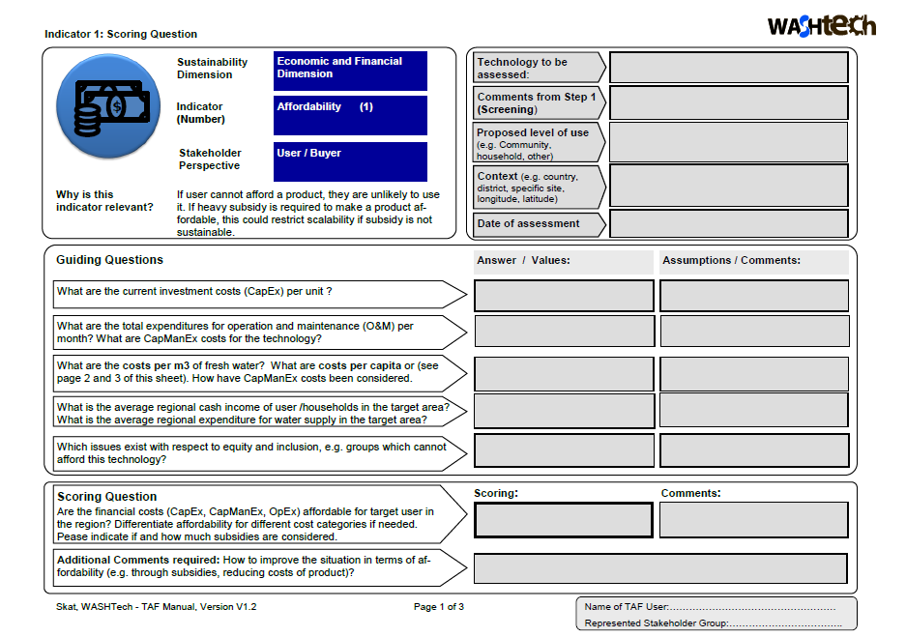

Slide 13
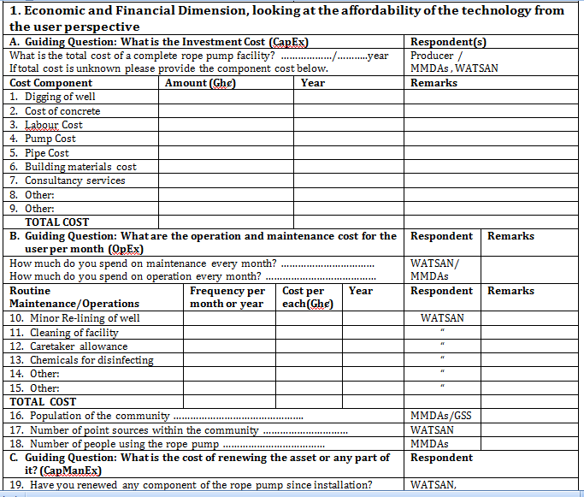
Indicator 1

Slide 14
Step 2: Assessment
  à  à  à 
Screening Assessment Presentation of Results Interpretation
Scoring method
To support the scoring additional information and links are provided on indicator sheets
Different views and scoring in a group are common
Different views should be made explicit
Reasons and implications for overall result of assessment should be discussed and documented
Transparent procedure supports acceptance of assessment results

Slide 15
Step 3: Presentation of Results
  à  à  à 
Screening Assessment Presentation of Results Interpretation
From Step 1: Screening results for criteria “need” and “applicability” and comments
From Step 2: Each score will be presented in a table as presented on the left
Comments from Step 2 are collected on a separate sheet, in particular if conflicting scoring appeared

Slide 16
Step 4: Interpretation
  à  à  à 
Screening Assessment Presentation of Results Interpretation
TAF Profile
Comprehensive interpretation including all these steps:
1) Step 1: Straight forward interpretation of screening results
2) Step 2: Interpretation
Per row → per dimension
Per column→ per perspective
3) TAF Graphical Profile → comprehensive assessment
4) Comments

Slide 17
Step 4: Interpretation
  à  à  à 
Screening Assessment Presentation of Results Interpretation
The TAF provides a comprehensive basis for decision making
The interpretation of results should consider all elements – from step 1 and from step 2
Implications from conflicting scoring should be made explicit
The process of TAF application supports acceptance of the assessment result and the development of specific mitigation measures for supporting the introduction process
All results and interpretation should be comprehensively documented

Slide 18
THANK YOU

