Slide 1
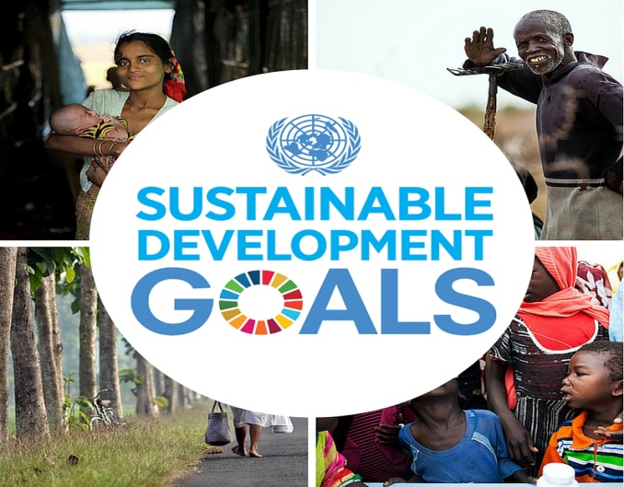
Sustainable Financing of the SDG’s/Global Goals: the role of grants and sponsorship Presentation Made at Mole XXVI: Financing the Sustainable Development Goals (SDGs): Options and Strategies for Ghana, 20th to 24th October, 2015 - Ex Tee Crystal Hotel, Bolgatanga, UER Dr. Afia S. Zakiya, Country Representative, WaterAid Ghana
Mole XXVI
Notes:
Dr. Afia S. Zakiya, Country Representative, WaterAid Ghana
The key objective is to discuss the SDGs with a focus on feasible strategies and innovative financial arrangement options for Ghana.
I. Introduction
WaterAid is engaging with post-2015 decision-makers to ensure the new Sustainable Development Goals include ambitious targets for universal access to water, sanitation and hygiene. We believe it is possible to end extreme poverty by 2030 and ensure sustainable development only by achieving universal access to water, sanitation and hygiene.
We believe the basic human right to water and sanitation is vital to development in education, health, welfare, economic growth and sustainability. To achieve universal access and address inequalities we must focus on reaching the poorest and most marginalised people. Their life and livelihood must be improved.
Our post-2015 vision is of a development framework that links poverty eradication and sustainable development. This must be supported by accountable governments and organisations around the world. ---
the current evolving development cooperation landscape; o the interrelationship of all sources of development finance; o the synergies between financing objectives across the three dimensions of sustainable development;
II. Past Experiences, funding the MDGs….Who gave, how they gave

Slide 2
OUTLINE
Introduction
Historical funding of the MDGs via Grants and sponsorship – WASH Sector Highlights
WASH Funding and the Politics of Sustaining Development Financing in the Post 2015 Era: Beyond the Savior Complex
How much poverty and how much funding for SDGs/GG is needed?
Conclusions & Recommendations
Notes:
Dr. Afia S. Zakiya, Country Representative, WaterAid Ghana
The key objective is to discuss the SDGs with a focus on feasible strategies and innovative financial arrangement options for Ghana.
I. Introduction
WaterAid is engaging with post-2015 decision-makers to ensure the new Sustainable Development Goals include ambitious targets for universal access to water, sanitation and hygiene. We believe it is possible to end extreme poverty by 2030 and ensure sustainable development only by achieving universal access to water, sanitation and hygiene.
We believe the basic human right to water and sanitation is vital to development in education, health, welfare, economic growth and sustainability. To achieve universal access and address inequalities we must focus on reaching the poorest and most marginalised people. Their life and livelihood must be improved.
Our post-2015 vision is of a development framework that links poverty eradication and sustainable development. This must be supported by accountable governments and organisations around the world. ---
the current evolving development cooperation landscape; o the interrelationship of all sources of development finance; o the synergies between financing objectives across the three dimensions of sustainable development;
II. Past Experiences, funding the MDGs….Who gave, how they gave

Slide 3
Can we change the world with 17 ?
Notes:
We are now in a new era and the world has committed to 17 steps to achieving sustainable development and (key) not leaving anyone behind.
Achieving ambitious sustainable development goals, especially those around water and sanitation, will take trillions of dollars. Is it time to change funding models? The MDG’s were woefully under funded and needed adjusting 3 times during the period, and still targets were not met.
Traditional aid will soon be a thing of the past, as the developed world are looking at the developing world to fund its own development projects. Unsurprisingly, the question of just how much capital will need to be raised to implement the SDGs (and, subsequently, how much of that need is currently unaccounted for) is a popular one among think tanks and policy pundits. The hope is that this exercise might help to bring new foreign assistance providers to the table or increase the commitments of existing donors. Unfortunately, though, this question neglects to address the other side of the ledger. The missing question: instead of simply raising more capital from already stretched donors, is it possible to provide more value from the funding already committed?
To be clear, this is not to question whether the agencies responsible for implementing foreign assistance programs are doing the best they can with what they have. Rather, it is to question whether those agencies have what they need in order to effectively carry out their mandates. Along with searching for additional financial resources, it is critical that the SDG process focus on developing and providing financial tools—such as access to banking, credit, and loans—that better equip development actors with power, choice, and flexibility in the way they manage their programs.
Surprisingly, the SDGs offer little by way of solutions to many of the biggest known drivers of global poverty. For example, the SDGs say nothing about the unfair trade regime of the World Trade Organisation, or the many bilateral trade and investment agreements that liberalise global markets at the expense of the poor. In fact, instead of tackling this crucial issue, Goal 17.10 calls for more trade liberalisation and more power for the WTO. Then there’s the question of funding. The United Nations acknowledges that the SDGs will require an annual outlay of some $2.5 trillion. How do they propose to bridge the funding shortfall?

Slide 4
I. Introduction
WaterAid is successfully engaging with post-2015 MDG decision-makers to ensure the new Sustainable Development Goals include ambitious targets for universal access to water, sanitation and hygiene - to end extreme poverty by 2030 and ensure sustainable development
Recognizing that 2.5 billion people currently live without access to improved sanitation, 1 billion people currently defecate in the open each day, and 748 million people live without access to clean, reliable water, our mission and vision to end WASH inequality and deprivation remains stronger than ever.
The basic human right to water and sanitation is vital to holistic development and contributes to the well-being, education, and health of all people. Our post-2015 vision therefore, is of a development framework that links poverty eradication and sustainable development.
Notes:
Dr. Afia S. Zakiya, Country Representative, WaterAid Ghana
The key objective is to discuss the SDGs with a focus on feasible strategies and innovative financial arrangement options for Ghana.
I. Introduction
WaterAid is engaging with post-2015 decision-makers to ensure the new Sustainable Development Goals include ambitious targets for universal access to water, sanitation and hygiene. We believe it is possible to end extreme poverty by 2030 and ensure sustainable development only by achieving universal access to water, sanitation and hygiene.
We believe the basic human right to water and sanitation is vital to development in education, health, welfare, economic growth and sustainability. To achieve universal access and address inequalities we must focus on reaching the poorest and most marginalised people. Their life and livelihood must be improved.
Our post-2015 vision is of a development framework that links poverty eradication and sustainable development. This must be supported by accountable governments and organisations around the world. ---
the current evolving development cooperation landscape; o the interrelationship of all sources of development finance; o the synergies between financing objectives across the three dimensions of sustainable development;
II. Past Experiences, funding the MDGs….Who gave, how they gave

Slide 5
I. Introduction
The current evolving development cooperation landscape sees:
the interrelationship of all sources of development finance;
the synergies between financing objectives across the three dimensions of sustainable development - economic, social and environmental aspects, and,
the recognition of their interlinkages, so as to achieve sustainable development in all its dimensions.
Women for water and sanitation declaration
WA’s vision is expressed in the declaration by Women for water and sanitation which calls for the global community to make improved drinking water, sanitation and hygiene (WASH) a top priority in the Post-2015 Development Agenda and to provide strong political and financial commitments towards universal access to WASH by 2030. WA is a signatory to the declaration
Notes:
Dr. Afia S. Zakiya, Country Representative, WaterAid Ghana
The key objective is to discuss the SDGs with a focus on feasible strategies and innovative financial arrangement options for Ghana.
I. Introduction
WaterAid is engaging with post-2015 decision-makers to ensure the new Sustainable Development Goals include ambitious targets for universal access to water, sanitation and hygiene. We believe it is possible to end extreme poverty by 2030 and ensure sustainable development only by achieving universal access to water, sanitation and hygiene.
We believe the basic human right to water and sanitation is vital to development in education, health, welfare, economic growth and sustainability. To achieve universal access and address inequalities we must focus on reaching the poorest and most marginalised people. Their life and livelihood must be improved.
Our post-2015 vision is of a development framework that links poverty eradication and sustainable development. This must be supported by accountable governments and organisations around the world. ---
the current evolving development cooperation landscape; o the interrelationship of all sources of development finance; o the synergies between financing objectives across the three dimensions of sustainable development;
II. Past Experiences, funding the MDGs….Who gave, how they gave

Slide 6
II. Historical funding of the MDGs via Grants and sponsorship – WASH Sector Highlights
Foundation Grants & Support for Water-related Issues Growing
March 2012 Foundation Center report, Foundation Funding for Water, Sanitation, and Hygiene noted that the number of U.S. charitable foundations awarding grants for water, sanitation, and hygiene (WASH) projects around the world had more than tripled. The report found that between 2003 and 2010 this growth in the number of active funders was accompanied by a nearly five-fold increase in the number of organizations receiving these grants, to the tune of $144 million in 2009-2010. And, while WASH funding as a proportion of international grantmaking overall grew from 0.2 percent in 2003, it remains very small (1.7 percent in 2010).
Notes:
Dr. Afia S. Zakiya, Country Representative, WaterAid Ghana
The key objective is to discuss the SDGs with a focus on feasible strategies and innovative financial arrangement options for Ghana.
I. Introduction
WaterAid is engaging with post-2015 decision-makers to ensure the new Sustainable Development Goals include ambitious targets for universal access to water, sanitation and hygiene. We believe it is possible to end extreme poverty by 2030 and ensure sustainable development only by achieving universal access to water, sanitation and hygiene.
We believe the basic human right to water and sanitation is vital to development in education, health, welfare, economic growth and sustainability. To achieve universal access and address inequalities we must focus on reaching the poorest and most marginalised people. Their life and livelihood must be improved.
Our post-2015 vision is of a development framework that links poverty eradication and sustainable development. This must be supported by accountable governments and organisations around the world. ---
the current evolving development cooperation landscape; o the interrelationship of all sources of development finance; o the synergies between financing objectives across the three dimensions of sustainable development;
II. Past Experiences, funding the MDGs….Who gave, how they gave

Slide 7
II. Historical funding of the MDGs via Grants and sponsorship – WASH Sector Highlights
Among other key findings in the report:
Number of funders: The total number of foundations awarding WASH grants has jumped from 24 in 2003 to 78 in 2010.
Geographic distribution: 30 percent of all grant dollars in 2009 and 2010 went to Africa, the largest share of any geographic region, while 18 percent went to Asia, and 9 percent went to Central/South America.
Purpose of grants: The largest proportion of foundation grant dollars support water sector policy and administration (20 percent), followed by basic drinking water supply (17 percent), WASH research (14 percent), and basic sanitation (14 percent).
Notes:
Dr. Afia S. Zakiya, Country Representative, WaterAid Ghana
The key objective is to discuss the SDGs with a focus on feasible strategies and innovative financial arrangement options for Ghana.
I. Introduction
WaterAid is engaging with post-2015 decision-makers to ensure the new Sustainable Development Goals include ambitious targets for universal access to water, sanitation and hygiene. We believe it is possible to end extreme poverty by 2030 and ensure sustainable development only by achieving universal access to water, sanitation and hygiene.
We believe the basic human right to water and sanitation is vital to development in education, health, welfare, economic growth and sustainability. To achieve universal access and address inequalities we must focus on reaching the poorest and most marginalised people. Their life and livelihood must be improved.
Our post-2015 vision is of a development framework that links poverty eradication and sustainable development. This must be supported by accountable governments and organisations around the world. ---
the current evolving development cooperation landscape; o the interrelationship of all sources of development finance; o the synergies between financing objectives across the three dimensions of sustainable development;
II. Past Experiences, funding the MDGs….Who gave, how they gave

Slide 8
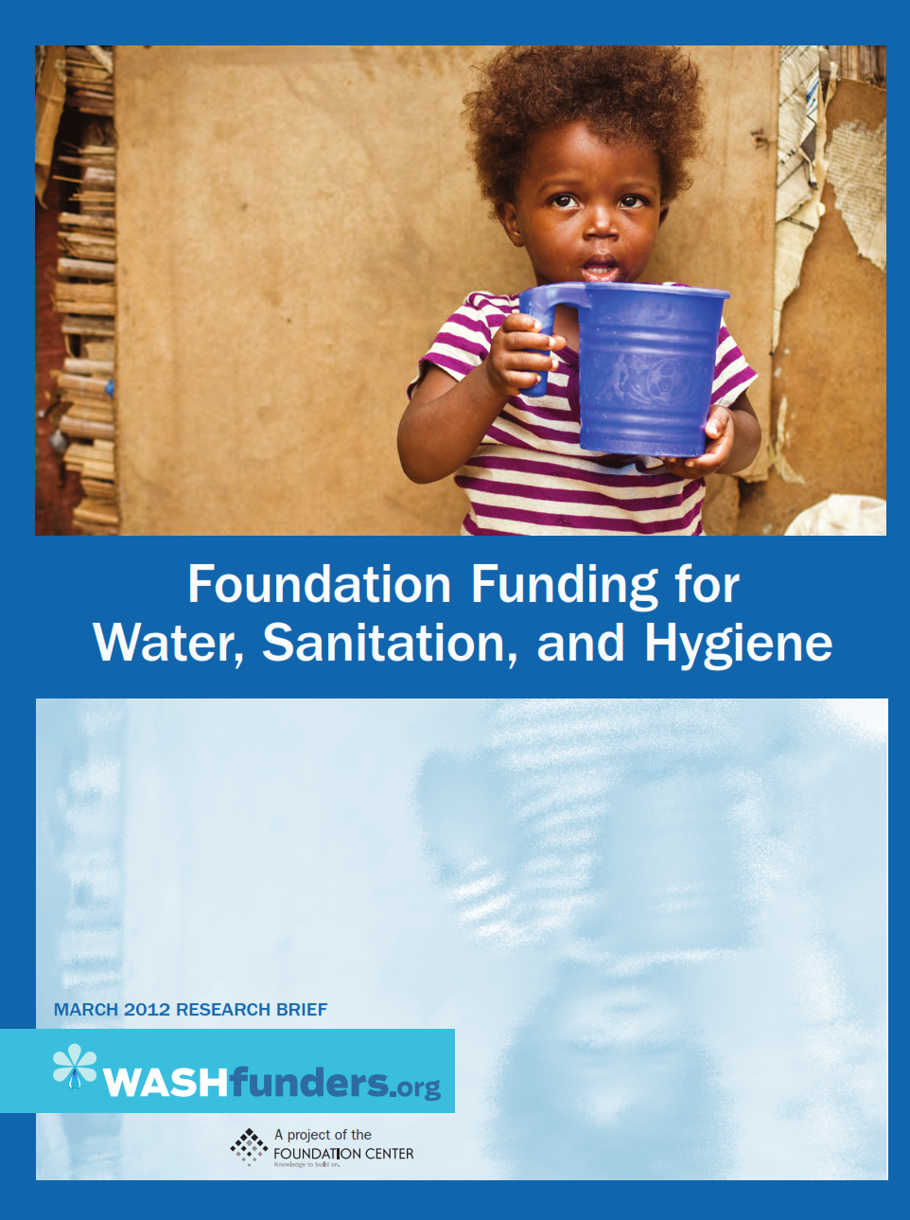

Slide 9
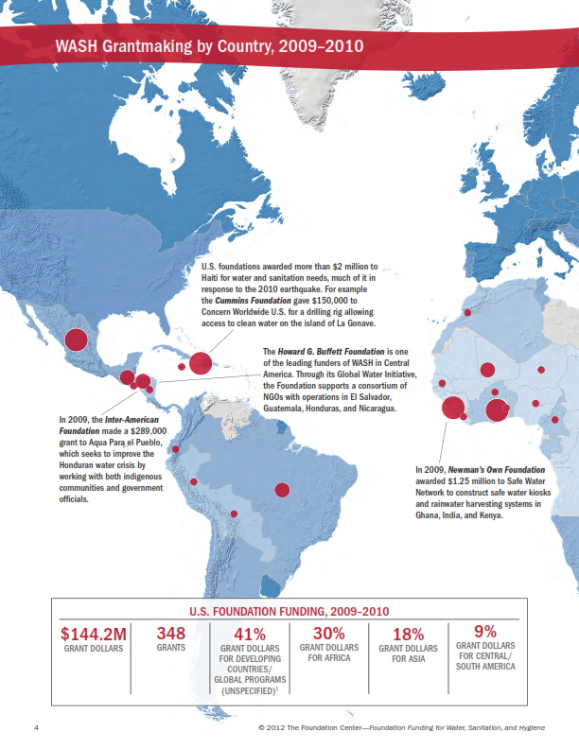

Slide 10
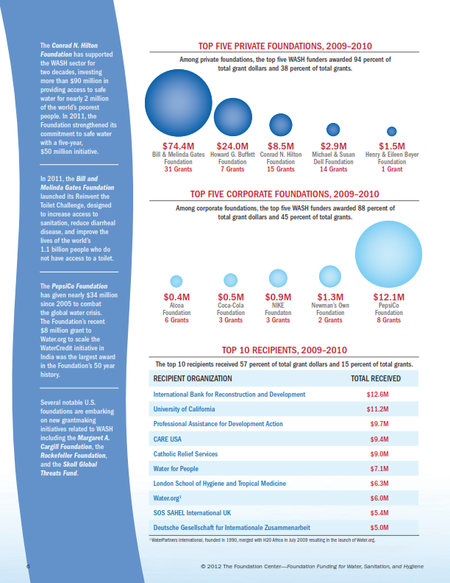

Slide 11
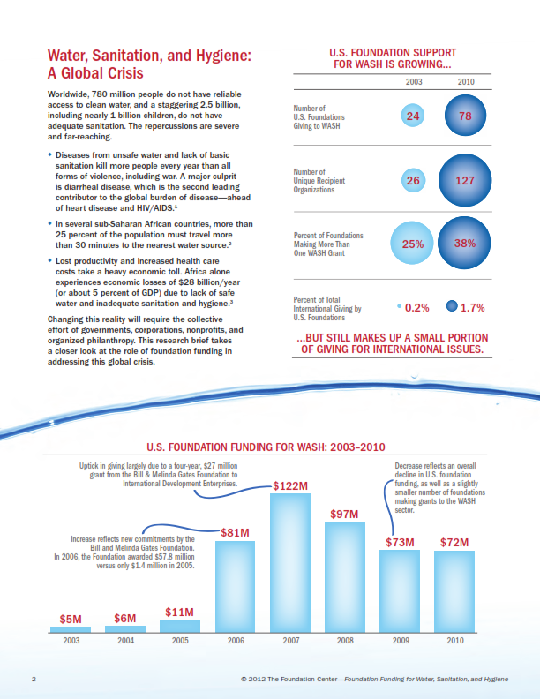

Slide 12
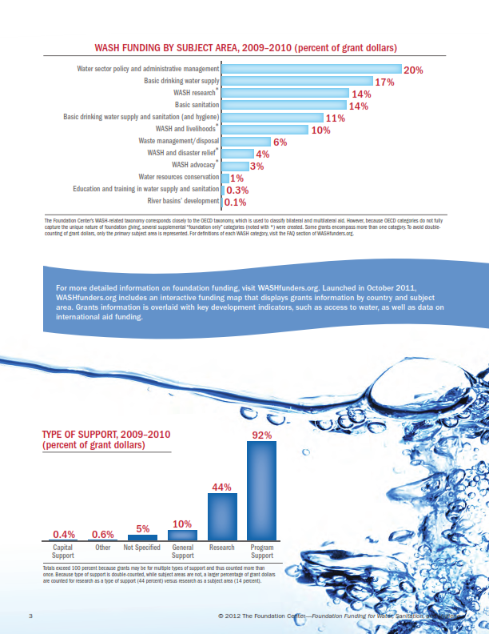

Slide 13
II. Historical funding of the MDGs via Grants and sponsorship – WASH Sector Highlights
GHANA – MDG Target of 87% w/improved drinking water
Foundations gave over $184.57Million to support MDG7
Since 2005 Foundations have increased their giving from 2billion – 4.5billion
MDG 7 received over 47% overall funding from foundations
2002-20012 – Ghana received $499 million
Notes:
We know from reports that the commitments and the actual from the MDGs were not honored across the board, the increase of loans also planned a key part in the success of the MDGs. However, under the banner of theses sources foundations and philanthropists contributed significant amounts to support Ghana’s quest in achieving MDG7
The giving of foundations has increased and Ghana remained a higher priority country for foundations who gave the most globally. WASH also remains key to Foundations as over 21% of MDG7 was funded by foundations. This offers vast contradictions to that of ODA funding which reduced commitments to WASH and with Ghana now a middle income country may insist on GoG using taxes revenue and other sources to fund this vital area.
Foundations filled the gaps were commitments and pledges fell short. The growing interest of foundations and philanthropy in development is growing and will play a bigger role in this new era of SDG’s.
Goal 7 received the most funding by Foundations 2000-2012, a massive 47%, 20% of funding was targeted at goal 7, 31% on goal 1 and 0% on goal 3 – questions what are the goals of OECD funds if not to tackle these issues.

Slide 14
II. Historical funding of the MDGs via Grants and sponsorship – WASH Sector Highlights
Conrad N. Hilton Foundation, The MasterCard Foundation, Ford Foundation, top funders of WASH, among others.
A new platform and partnership funded in part by these foundations - the SDG Philanthropy Platform — a partnership of the United Nations Development Programme, Foundation Center, and Rockefeller Philanthropy Advisors, with support from the MasterCard, Ford, and Conrad N. Hilton foundations, — has since 2014, included building a knowledge base to promote philanthropy's role in planning, monitoring, evaluating, and implementing the SDGs.
The report, Engaging Philanthropy in the Post-2015 Development Agenda: Lessons Learned and Ways Forward – funded by the Ford, Hilton and Mastercard Foundations, notes that while philanthropy is an increasingly important player in development efforts, individual funders have tended to violate Aid effectiveness principles by working independently of government- and UN-led frameworks such as the MDGs, even as they made significant investments in areas including global health, education, access to clean water, and child survival.
Notes:
We know from reports that the commitments and the actual from the MDGs were not honored across the board, the increase of loans also planned a key part in the success of the MDGs. However, under the banner of theses sources foundations and philanthropists contributed significant amounts to support Ghana’s quest in achieving MDG7
The giving of foundations has increased and Ghana remained a higher priority country for foundations who gave the most globally. WASH also remains key to Foundations as over 21% of MDG7 was funded by foundations. This offers vast contradictions to that of ODA funding which reduced commitments to WASH and with Ghana now a middle income country may insist on GoG using taxes revenue and other sources to fund this vital area.
Foundations filled the gaps were commitments and pledges fell short. The growing interest of foundations and philanthropy in development is growing and will play a bigger role in this new era of SDG’s.
Goal 7 received the most funding by Foundations 2000-2012, a massive 47%, 20% of funding was targeted at goal 7, 31% on goal 1 and 0% on goal 3 – questions what are the goals of OECD funds if not to tackle these issues.

Slide 15
II. Historical funding of the MDGs via Grants and sponsorship – WASH Sector Highlights
The SDG Philanthropy Platform has launched SDGfunders.org, a website designed to facilitate funder engagement in the global development process and cross-sector collaboration through knowledge sharing and access to critical data. Powered by Foundation Center, the site offers interactive maps and dashboards tracking key funding data (both philanthropic and ODA- official development assistance) on individual Millennium Development Goals, SDGs, countries, and population groups. It also lists top funders and recipients working on specific SDGs, and provides access to literature including case studies and interviews with experts. It will host an online community that will serve as a hub for discussions and knowledge sharing worldwide.
The Foundation Center also has the WASHfunders.org custom web portal. As a hub for funders, practitioners, and policymakers working around the world, the portal provides free access to a broad set of knowledge resources, including a mapping tool with detailed grants information, case studies of WASH project funding around the world, and a searchable archive of reports. Foundation Funding for Water, Sanitation, and Hygiene can be downloaded at no charge from the Foundation Center's web site..
Notes:
We know from reports that the commitments and the actual from the MDGs were not honored across the board, the increase of loans also planned a key part in the success of the MDGs. However, under the banner of theses sources foundations and philanthropists contributed significant amounts to support Ghana’s quest in achieving MDG7
The giving of foundations has increased and Ghana remained a higher priority country for foundations who gave the most globally. WASH also remains key to Foundations as over 21% of MDG7 was funded by foundations. This offers vast contradictions to that of ODA funding which reduced commitments to WASH and with Ghana now a middle income country may insist on GoG using taxes revenue and other sources to fund this vital area.
Foundations filled the gaps were commitments and pledges fell short. The growing interest of foundations and philanthropy in development is growing and will play a bigger role in this new era of SDG’s.
Goal 7 received the most funding by Foundations 2000-2012, a massive 47%, 20% of funding was targeted at goal 7, 31% on goal 1 and 0% on goal 3 – questions what are the goals of OECD funds if not to tackle these issues.

Slide 16
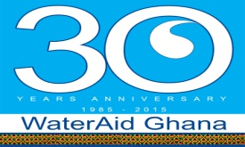
MDGs – gone but not forgotten WASHFunders.org - SDGfunder.org
Notes:
From MDG’s to SDG’s
OCED(Organization for Economic Cooperation and development disbursements in Ghana for WASH (all categories) was generally led by funding from bilateral (government agency based in country which provides aid, changing trends since 2005 (5 years into the MDGs) that multilateral funding (from agencies in multiple countries working together on a given issue is in increasing the need to address our WASH issues.
We can see from the graph the pictorial increase/decrease of the two categories
Changes in Foundation funding has grown from under 100million in 2005 to 600Million in 2012 – this is rapid growth over the period and one set to increase into the SDG era
ODA (Official Development Assistance) went from just over 1.5billion to over 4.5billion in 2012 – totaling 2.3% increase across 11 years.
Without support from foundations Ghana would not have met the MDG if it was reliant on ODA/Aid. For many developing countries Foundations played a crucial role in funding MDG’s, of their total grantmaking 54% of grants were aimed at tackling at least on of the 8 MDGs.
Foundation Support for Water-related Issues Growing
New York, NY — March 20, 2012. In recent years, the number of U.S. charitable foundations awarding grants for water, sanitation, and hygiene (WASH) projects around the world has more than tripled. A new research brief by the Foundation Center, Foundation Funding for Water, Sanitation, and Hygiene, finds that between 2003 and 2010 this growth in the number of active funders was accompanied by a nearly five-fold increase in the number of organizations receiving these grants, to the tune of $144 million in 2009-2010. And, while WASH funding as a proportion of international grantmaking overall has grown from 0.2 percent in 2003, it remains very small (1.7 percent in 2010).
Among other key findings in the report:
Number of funders: The total number of foundations awarding WASH grants has jumped from 24 in 2003 to 78 in 2010.
Geographic distribution: 30 percent of all grant dollars in 2009 and 2010 went to Africa, the largest share of any geographic region, while 18 percent went to Asia, and 9 percent went to Central/South America.
Purpose of grants: The largest proportion of foundation grant dollars support water sector policy and administration (20 percent), followed by basic drinking water supply (17 percent), WASH research (14 percent), and basic sanitation (14 percent).
More than 780 million people do not have reliable access to clean water, and a staggering 2.5 billion do not have adequate sanitation. This report looks at the role of foundation funding in addressing this global crisis, complementing the Foundation Center's WASHfunders.org custom web portal. As a hub for funders, practitioners, and policymakers working around the world, the portal provides free access to a broad set of knowledge resources, including a mapping tool with detailed grants information, case studies of WASH project funding around the world, and a searchable archive of reports. The Foundation Center's custom web portals empower donors to be more strategic, using data-driven decision making and peer-to-peer insights to strengthen their philanthropy.
Foundation Funding for Water, Sanitation, and Hygiene can be downloaded at no charge from the Foundation Center's web site.

Slide 17
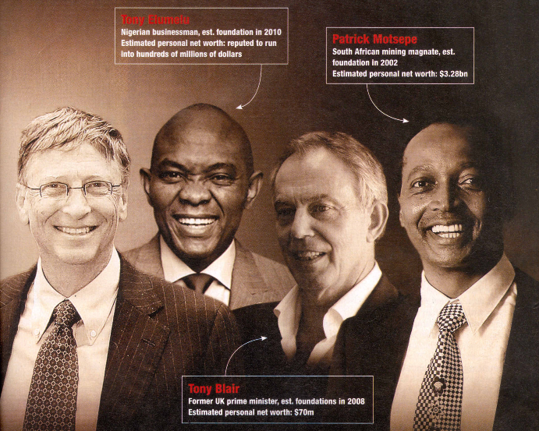
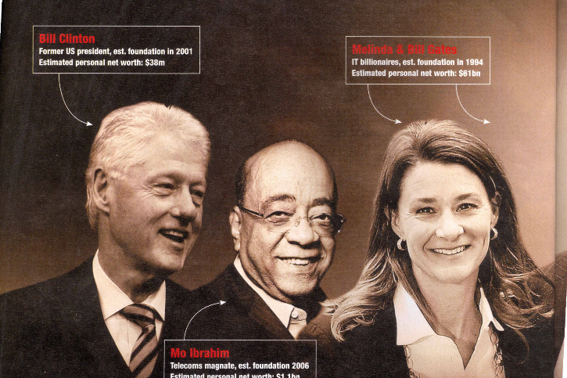
Emerging Trends in International Development & Foundation Giving/Philanthrophy: Whither Philanthrocapitalism?
Presentation to the Ghana INGO Forum October 30, 2013
by
Afia S. Zakiya, Ph.D. Country Representative

Slide 18
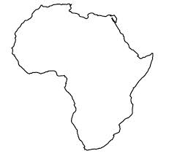
Philanthrocapitalism in Africa
The Africa Report No. 47
February 2013

Slide 19
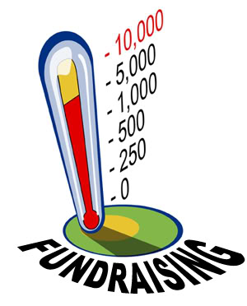
Philanthrocapitalism in Africa
In Africa, development is now linked to key “Philanthrocapitalists” such as Bill and Melinda Gates, Warren Buffett, Bill Clinton, Kofi Annan, George Soros, Mo Ibrahim, Bono, Tony Blair, Aliko Dangote, Theophilus Danjuma, Tony Elumelu (Nigeria), Patrice Motsepe and Tokyo Sexwale (SA)

Slide 20
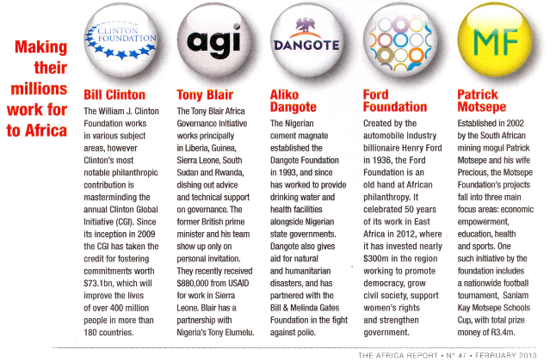

Slide 21
III. WASH Funding and the Politics of Sustaining Development Financing in the Post 2015 Era: Beyond the Savior Complex
On 14 July 2015 At the Third International Conference on Financing for Development in Addis Ababa, the Government of Ethiopia and WaterAid convened a high-level panel of experts to discuss financing universal access to water, sanitation and hygiene (WASH) by 2030. The debate focused on how to successfully integrate funding WASH with other Sustainable Development Goals (SDGs). Key areas of focus included:
The challenges in addressing estimated national financing gaps in resourcing universal access by 2030, including the role of Official Development Assistance (ODA);
How to ensure the sustainability of WASH programmes.
How WASH investments can act as a catalyst for social and economic development.
WaterAid’s 2015 research on aid flows which showed that 45 countries are in need of increased aid investments, mechanisms for the localisation of the SDGs, strengthened national statistical institutions, and effective reporting of progress by countries on the SDGs worldwide.
Notes:
Who paid for the MDGs? Foreign aid budgets and debt relief where (largely) used to tackle the MDGs, but these tactics will not be used to support the ambitious SDGs. Many estimate that trillions (not billions) will be needed to support the SGDs. The SDG 6- sustainable management of water and sanitation for all’ will cost $27bn a year or $290bn if infrastructure is included. That said much external financing is available now than when the MDG’s started.
The challenge facing developed countries (now) is ensuring the aid is used to build the cap city of governments to deliver sustainable services for all.
The road to finalized the SDG’s has included a number of high level meetings, most notably in Addis Ethiopia, where this question of funding was tackled. The decision was that developing countries will be expected to meet the lion share through their own public finances and resources, with foreign governments and international agencies set to take a back seat.
Sustainable development goals are far more ambitious then the MDGs which some felt fell short of tackling the real root of poverty. Some MDG’s were exceeded and others fell short, but all expired in September of this year.
Substantial progress has been made regarding the MDGs. The world has already realized the first MDG of halving the extreme poverty rate by 2015. However, the achievements have been uneven. The MDGs are set to expire in 2015 and the discussion of a post-2015 agenda continues.
The focus is now on building a sustainable world where environmental sustainability, social inclusion, and economic development are equally valued. The SDG Fund, building on the experience and lessons learned from the MDG Achievement Fund, is the first mechanism specifically created to achieve the SDGs.
Traditional aid- for middle income countries such as Ghana may see significant reductions, but the SDGs are committed to leaving no behind, so time will tell how what aid is available for countries with that status but fail to raise funds in other areas. WaterAid has produced a report outlining countries (45) in need of aid to ensure goal 6 is meet. Ghana is on that list.
Philanthropy – bridge the gaps between UN and government, private sector bodies. They provide more of an inclusive approach. Will bring finances and skills, knowledge, data all of which support effective outcomes
Philanthropic organizations should play a direct role in implementing the United Nations' Sustainable Development Goals by collaborating with UN agencies, civil society organizations, governments, and businesses, a report from the SDG Philanthropy Platform urges. The report, Engaging Philanthropy in the Post-2015 Development Agenda: Lessons Learned and Ways Forward (44 pages, PDF), notes that while philanthropy is an increasingly important player in development efforts, individual funders have tended to work independently of government- and UN-led frameworks such as the Millennium Development Goals, even as they made significant investments in areas including global health, education, access to clean water, and child survival. By aligning their work with the SDGs and coordinating with other stakeholders, the report argues, foundations can help shape the development process, increase the efficiency of their own efforts, and measure performance against global indicators. Funded in part by the Ford, Conrad N. Hilton, and MasterCard foundations, the report also highlights the accomplishments of the SDG Philanthropy Platform — a partnership of the United Nations Development Programme, Foundation Center, and Rockefeller Philanthropy Advisors — since 2014, including building a knowledge base to promote philanthropy's role in planning, monitoring, evaluating, and implementing the SDGs.
"Governments alone cannot address the critical challenges of sustainable development, nor can we expect philanthropy to achieve its maximum potential operating in isolation," said UNDP administrator Helen Clark. "The SDG Platform for Philanthropy will create the linkages necessary to achieve the SDGs, and, ultimately, a more just and equitable society."
Private sector – PPP’s and market based approaches are becoming an increasing in Ghana and contributed massively to the latter years of the MDGs in Ghana. Moving forward method will become more increasingly used as a means of mobilizing private flows of money to address development needs. This area require careful evaluation to ensure the services are affordable for the poor. The environment also needs to be strengthen in order to support more PPP’s, so loan facilities need to be made available for business to access the funding needed to entre agreements.
Foundations – offer flexible funding not tied to foreign policies, they often take a longer term approach and they to support multiple countries which fosters positive cross-national learning an innovations. One two INGO’s were in the top 10 list of recipients (IRC/World Vision), the majority were educational institutes
Domestic finance – its envisaged that countries will be raising collecting more tax (individuals/company/property) and not using it centrally but rather using it at district/municipal level. We all know the GoG doesn’t collect enough to maintain existing costs, let alone the costs to deliver on the SDGs and sustain those achieved through the MDGs. CSO, civil society also need to ensure accountability, action and transparency to ensure governments use the money appropriately
As a sector, not just WASH but NGO/INGO/CSO’s we need to embrace the new channels of funding and work to design and implement appropriate sustainable programmes. Wateraid globally is going through a shift since the launch of our strategy and on the ground here in Ghana we are working developing our new strategy which outlines a new of key shifts in the way we will work with you, our donors and key stakeholders.
What does this mean for Ghana, our sector and WaterAid Ghana???
It means we will need to change the way we do things. The traditional forms of aid are drying up and those set to replace them are looking at innovative ways to address issues which are sustainable. Programmes need to be less about numbers and more about long term impact, capacity and institutional building.

Slide 22
III. WASH Funding and the Politics of Sustaining Development Financing in the Post 2015 Era: Beyond the Savior Complex
there will be more funding and competition among existing and new INGOs and NGOs, for grants and sponsored funding
the SDGs if achieved, will be done so without the assurance of guaranteed funding and come primarily from ‘developed’ nations that ‘give’ based on the premise of the “global partnership for development’’
Deeper aid dependent relationships are predicted to emerge that put the attainment of the SDGs into serious challenges
Notes:
We know from reports that the commitments and the actual from the MDGs were not honored across the board, the increase of loans also planned a key part in the success of the MDGs. However, under the banner of theses sources foundations and philanthropists contributed significant amounts to support Ghana’s quest in achieving MDG7
The giving of foundations has increased and Ghana remained a higher priority country for foundations who gave the most globally. WASH also remains key to Foundations as over 21% of MDG7 was funded by foundations. This offers vast contradictions to that of ODA funding which reduced commitments to WASH and with Ghana now a middle income country may insist on GoG using taxes revenue and other sources to fund this vital area.
Foundations filled the gaps were commitments and pledges fell short. The growing interest of foundations and philanthropy in development is growing and will play a bigger role in this new era of SDG’s.
Goal 7 received the most funding by Foundations 2000-2012, a massive 47%, 20% of funding was targeted at goal 7, 31% on goal 1 and 0% on goal 3 – questions what are the goals of OECD funds if not to tackle these issues.

Slide 23
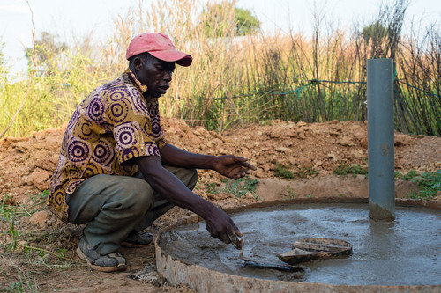
III. WASH Funding and the Politics of Sustaining Development Financing in the Post 2015 Era: Beyond the Savior Complex
Major Challenge:
As the source of financing is not based on the size of the economies and the GDP of the respective LDCs but depends on foreign aid as the main source of financing, there is no independent financial pathway for developing countries to achieve the SDGs other than ODA, debt relief, aid and grants. This was the politics of the past and may continue…
Notes:
We know from reports that the commitments and the actual from the MDGs were not honored across the board, the increase of loans also planned a key part in the success of the MDGs. However, under the banner of theses sources foundations and philanthropists contributed significant amounts to support Ghana’s quest in achieving MDG7
The giving of foundations has increased and Ghana remained a higher priority country for foundations who gave the most globally. WASH also remains key to Foundations as over 21% of MDG7 was funded by foundations. This offers vast contradictions to that of ODA funding which reduced commitments to WASH and with Ghana now a middle income country may insist on GoG using taxes revenue and other sources to fund this vital area.
Foundations filled the gaps were commitments and pledges fell short. The growing interest of foundations and philanthropy in development is growing and will play a bigger role in this new era of SDG’s.
Goal 7 received the most funding by Foundations 2000-2012, a massive 47%, 20% of funding was targeted at goal 7, 31% on goal 1 and 0% on goal 3 – questions what are the goals of OECD funds if not to tackle these issues.

Slide 24
III. WASH Funding and the Politics of Sustaining Development Financing in the Post 2015 Era: Beyond the Savior Complex
While funding for the SDGs and SDG/GG 6 for WASH will soon take off, the above challenges point WAG towards the position that LOCAL GOVERNMENT FUNDING SHOULD BE FOCUS OF AID in an effort to SUPPORT DECENTRALIZATION of funds to the lowest level of government to reach the poorest and most marginalized.
Towards this end, WAG in our new strategy for 2015-2020 towards a concerted push for universal access to WASH by 2025 (GoG target) and/or 2030 (WA & SDG Target), will seek to COORDINATE a District Wide Approach in using its funding in collaboration with GoG, and other sector actors serious about adhering to agreed AID EFFECTIVENESS PRINCIPLES.
Decentralization of funding to MMDAs is prioritized, and the ability of MMDAs to deliver WASH and wider development, and generate local revenues.
Notes:
Who paid for the MDGs? Foreign aid budgets and debt relief where (largely) used to tackle the MDGs, but these tactics will not be used to support the ambitious SDGs. Many estimate that trillions (not billions) will be needed to support the SGDs. The SDG 6- sustainable management of water and sanitation for all’ will cost $27bn a year or $290bn if infrastructure is included. That said much external financing is available now than when the MDG’s started.
The challenge facing developed countries (now) is ensuring the aid is used to build the cap city of governments to deliver sustainable services for all.
The road to finalized the SDG’s has included a number of high level meetings, most notably in Addis Ethiopia, where this question of funding was tackled. The decision was that developing countries will be expected to meet the lion share through their own public finances and resources, with foreign governments and international agencies set to take a back seat.
Sustainable development goals are far more ambitious then the MDGs which some felt fell short of tackling the real root of poverty. Some MDG’s were exceeded and others fell short, but all expired in September of this year.
Substantial progress has been made regarding the MDGs. The world has already realized the first MDG of halving the extreme poverty rate by 2015. However, the achievements have been uneven. The MDGs are set to expire in 2015 and the discussion of a post-2015 agenda continues.
The focus is now on building a sustainable world where environmental sustainability, social inclusion, and economic development are equally valued. The SDG Fund, building on the experience and lessons learned from the MDG Achievement Fund, is the first mechanism specifically created to achieve the SDGs.
Traditional aid- for middle income countries such as Ghana may see significant reductions, but the SDGs are committed to leaving no behind, so time will tell how what aid is available for countries with that status but fail to raise funds in other areas. WaterAid has produced a report outlining countries (45) in need of aid to ensure goal 6 is meet. Ghana is on that list.
Philanthropy – bridge the gaps between UN and government, private sector bodies. They provide more of an inclusive approach. Will bring finances and skills, knowledge, data all of which support effective outcomes
Philanthropic organizations should play a direct role in implementing the United Nations' Sustainable Development Goals by collaborating with UN agencies, civil society organizations, governments, and businesses, a report from the SDG Philanthropy Platform urges. The report, Engaging Philanthropy in the Post-2015 Development Agenda: Lessons Learned and Ways Forward (44 pages, PDF), notes that while philanthropy is an increasingly important player in development efforts, individual funders have tended to work independently of government- and UN-led frameworks such as the Millennium Development Goals, even as they made significant investments in areas including global health, education, access to clean water, and child survival. By aligning their work with the SDGs and coordinating with other stakeholders, the report argues, foundations can help shape the development process, increase the efficiency of their own efforts, and measure performance against global indicators. Funded in part by the Ford, Conrad N. Hilton, and MasterCard foundations, the report also highlights the accomplishments of the SDG Philanthropy Platform — a partnership of the United Nations Development Programme, Foundation Center, and Rockefeller Philanthropy Advisors — since 2014, including building a knowledge base to promote philanthropy's role in planning, monitoring, evaluating, and implementing the SDGs.
"Governments alone cannot address the critical challenges of sustainable development, nor can we expect philanthropy to achieve its maximum potential operating in isolation," said UNDP administrator Helen Clark. "The SDG Platform for Philanthropy will create the linkages necessary to achieve the SDGs, and, ultimately, a more just and equitable society."
Private sector – PPP’s and market based approaches are becoming an increasing in Ghana and contributed massively to the latter years of the MDGs in Ghana. Moving forward method will become more increasingly used as a means of mobilizing private flows of money to address development needs. This area require careful evaluation to ensure the services are affordable for the poor. The environment also needs to be strengthen in order to support more PPP’s, so loan facilities need to be made available for business to access the funding needed to entre agreements.
Foundations – offer flexible funding not tied to foreign policies, they often take a longer term approach and they to support multiple countries which fosters positive cross-national learning an innovations. One two INGO’s were in the top 10 list of recipients (IRC/World Vision), the majority were educational institutes
Domestic finance – its envisaged that countries will be raising collecting more tax (individuals/company/property) and not using it centrally but rather using it at district/municipal level. We all know the GoG doesn’t collect enough to maintain existing costs, let alone the costs to deliver on the SDGs and sustain those achieved through the MDGs. CSO, civil society also need to ensure accountability, action and transparency to ensure governments use the money appropriately
As a sector, not just WASH but NGO/INGO/CSO’s we need to embrace the new channels of funding and work to design and implement appropriate sustainable programmes. Wateraid globally is going through a shift since the launch of our strategy and on the ground here in Ghana we are working developing our new strategy which outlines a new of key shifts in the way we will work with you, our donors and key stakeholders.
What does this mean for Ghana, our sector and WaterAid Ghana???
It means we will need to change the way we do things. The traditional forms of aid are drying up and those set to replace them are looking at innovative ways to address issues which are sustainable. Programmes need to be less about numbers and more about long term impact, capacity and institutional building.

Slide 25
IV. How much poverty and how much funding for SDGs/GG is needed?
Jason Hickel is a lecturer, London School of Economics and Political Science.
Notes:
Who paid for the MDGs? Foreign aid budgets and debt relief where (largely) used to tackle the MDGs, but these tactics will not be used to support the ambitious SDGs. Many estimate that trillions (not billions) will be needed to support the SGDs. The SDG 6- sustainable management of water and sanitation for all’ will cost $27bn a year or $290bn if infrastructure is included. That said much external financing is available now than when the MDG’s started.
The challenge facing developed countries (now) is ensuring the aid is used to build the cap city of governments to deliver sustainable services for all.
The road to finalized the SDG’s has included a number of high level meetings, most notably in Addis Ethiopia, where this question of funding was tackled. The decision was that developing countries will be expected to meet the lion share through their own public finances and resources, with foreign governments and international agencies set to take a back seat.
Sustainable development goals are far more ambitious then the MDGs which some felt fell short of tackling the real root of poverty. Some MDG’s were exceeded and others fell short, but all expired in September of this year.
Substantial progress has been made regarding the MDGs. The world has already realized the first MDG of halving the extreme poverty rate by 2015. However, the achievements have been uneven. The MDGs are set to expire in 2015 and the discussion of a post-2015 agenda continues.
The focus is now on building a sustainable world where environmental sustainability, social inclusion, and economic development are equally valued. The SDG Fund, building on the experience and lessons learned from the MDG Achievement Fund, is the first mechanism specifically created to achieve the SDGs.
Traditional aid- for middle income countries such as Ghana may see significant reductions, but the SDGs are committed to leaving no behind, so time will tell how what aid is available for countries with that status but fail to raise funds in other areas. WaterAid has produced a report outlining countries (45) in need of aid to ensure goal 6 is meet. Ghana is on that list.
Philanthropy – bridge the gaps between UN and government, private sector bodies. They provide more of an inclusive approach. Will bring finances and skills, knowledge, data all of which support effective outcomes
Philanthropic organizations should play a direct role in implementing the United Nations' Sustainable Development Goals by collaborating with UN agencies, civil society organizations, governments, and businesses, a report from the SDG Philanthropy Platform urges. The report, Engaging Philanthropy in the Post-2015 Development Agenda: Lessons Learned and Ways Forward (44 pages, PDF), notes that while philanthropy is an increasingly important player in development efforts, individual funders have tended to work independently of government- and UN-led frameworks such as the Millennium Development Goals, even as they made significant investments in areas including global health, education, access to clean water, and child survival. By aligning their work with the SDGs and coordinating with other stakeholders, the report argues, foundations can help shape the development process, increase the efficiency of their own efforts, and measure performance against global indicators. Funded in part by the Ford, Conrad N. Hilton, and MasterCard foundations, the report also highlights the accomplishments of the SDG Philanthropy Platform — a partnership of the United Nations Development Programme, Foundation Center, and Rockefeller Philanthropy Advisors — since 2014, including building a knowledge base to promote philanthropy's role in planning, monitoring, evaluating, and implementing the SDGs.
"Governments alone cannot address the critical challenges of sustainable development, nor can we expect philanthropy to achieve its maximum potential operating in isolation," said UNDP administrator Helen Clark. "The SDG Platform for Philanthropy will create the linkages necessary to achieve the SDGs, and, ultimately, a more just and equitable society."
Private sector – PPP’s and market based approaches are becoming an increasing in Ghana and contributed massively to the latter years of the MDGs in Ghana. Moving forward method will become more increasingly used as a means of mobilizing private flows of money to address development needs. This area require careful evaluation to ensure the services are affordable for the poor. The environment also needs to be strengthen in order to support more PPP’s, so loan facilities need to be made available for business to access the funding needed to entre agreements.
Foundations – offer flexible funding not tied to foreign policies, they often take a longer term approach and they to support multiple countries which fosters positive cross-national learning an innovations. One two INGO’s were in the top 10 list of recipients (IRC/World Vision), the majority were educational institutes
Domestic finance – its envisaged that countries will be raising collecting more tax (individuals/company/property) and not using it centrally but rather using it at district/municipal level. We all know the GoG doesn’t collect enough to maintain existing costs, let alone the costs to deliver on the SDGs and sustain those achieved through the MDGs. CSO, civil society also need to ensure accountability, action and transparency to ensure governments use the money appropriately
As a sector, not just WASH but NGO/INGO/CSO’s we need to embrace the new channels of funding and work to design and implement appropriate sustainable programmes. Wateraid globally is going through a shift since the launch of our strategy and on the ground here in Ghana we are working developing our new strategy which outlines a new of key shifts in the way we will work with you, our donors and key stakeholders.
What does this mean for Ghana, our sector and WaterAid Ghana???
It means we will need to change the way we do things. The traditional forms of aid are drying up and those set to replace them are looking at innovative ways to address issues which are sustainable. Programmes need to be less about numbers and more about long term impact, capacity and institutional building.

Slide 26
IV. How much poverty and how much funding for SDGs/GG is needed? - A Critique
Hickel argues the SDGs will not deliver the new economy the world needs because of “the pathologies of accumulation”:
SDGs do not touch the wealth and power of the global 1%. They fail to understand a basic fact: Mass poverty is the product of extreme wealth accumulation and over-consumption by a few.
they will lock in the global development agenda for the next 15 years around a failing economic model that requires urgent and deep structural changes
They do not regulate corporate extraction – a major issue in Ghana where millions of lost revenues occur from OIL, Gold, and other extractive industries
The debt issue is evaded: the SDGs refuse to call for debt cancellation even though debt service drains developing countries of more than US $700 billion per year.
Notes:
Who paid for the MDGs? Foreign aid budgets and debt relief where (largely) used to tackle the MDGs, but these tactics will not be used to support the ambitious SDGs. Many estimate that trillions (not billions) will be needed to support the SGDs. The SDG 6- sustainable management of water and sanitation for all’ will cost $27bn a year or $290bn if infrastructure is included. That said much external financing is available now than when the MDG’s started.
The challenge facing developed countries (now) is ensuring the aid is used to build the cap city of governments to deliver sustainable services for all.
The road to finalized the SDG’s has included a number of high level meetings, most notably in Addis Ethiopia, where this question of funding was tackled. The decision was that developing countries will be expected to meet the lion share through their own public finances and resources, with foreign governments and international agencies set to take a back seat.
Sustainable development goals are far more ambitious then the MDGs which some felt fell short of tackling the real root of poverty. Some MDG’s were exceeded and others fell short, but all expired in September of this year.
Substantial progress has been made regarding the MDGs. The world has already realized the first MDG of halving the extreme poverty rate by 2015. However, the achievements have been uneven. The MDGs are set to expire in 2015 and the discussion of a post-2015 agenda continues.
The focus is now on building a sustainable world where environmental sustainability, social inclusion, and economic development are equally valued. The SDG Fund, building on the experience and lessons learned from the MDG Achievement Fund, is the first mechanism specifically created to achieve the SDGs.
Traditional aid- for middle income countries such as Ghana may see significant reductions, but the SDGs are committed to leaving no behind, so time will tell how what aid is available for countries with that status but fail to raise funds in other areas. WaterAid has produced a report outlining countries (45) in need of aid to ensure goal 6 is meet. Ghana is on that list.
Philanthropy – bridge the gaps between UN and government, private sector bodies. They provide more of an inclusive approach. Will bring finances and skills, knowledge, data all of which support effective outcomes
Philanthropic organizations should play a direct role in implementing the United Nations' Sustainable Development Goals by collaborating with UN agencies, civil society organizations, governments, and businesses, a report from the SDG Philanthropy Platform urges. The report, Engaging Philanthropy in the Post-2015 Development Agenda: Lessons Learned and Ways Forward (44 pages, PDF), notes that while philanthropy is an increasingly important player in development efforts, individual funders have tended to work independently of government- and UN-led frameworks such as the Millennium Development Goals, even as they made significant investments in areas including global health, education, access to clean water, and child survival. By aligning their work with the SDGs and coordinating with other stakeholders, the report argues, foundations can help shape the development process, increase the efficiency of their own efforts, and measure performance against global indicators. Funded in part by the Ford, Conrad N. Hilton, and MasterCard foundations, the report also highlights the accomplishments of the SDG Philanthropy Platform — a partnership of the United Nations Development Programme, Foundation Center, and Rockefeller Philanthropy Advisors — since 2014, including building a knowledge base to promote philanthropy's role in planning, monitoring, evaluating, and implementing the SDGs.
"Governments alone cannot address the critical challenges of sustainable development, nor can we expect philanthropy to achieve its maximum potential operating in isolation," said UNDP administrator Helen Clark. "The SDG Platform for Philanthropy will create the linkages necessary to achieve the SDGs, and, ultimately, a more just and equitable society."
Private sector – PPP’s and market based approaches are becoming an increasing in Ghana and contributed massively to the latter years of the MDGs in Ghana. Moving forward method will become more increasingly used as a means of mobilizing private flows of money to address development needs. This area require careful evaluation to ensure the services are affordable for the poor. The environment also needs to be strengthen in order to support more PPP’s, so loan facilities need to be made available for business to access the funding needed to entre agreements.
Foundations – offer flexible funding not tied to foreign policies, they often take a longer term approach and they to support multiple countries which fosters positive cross-national learning an innovations. One two INGO’s were in the top 10 list of recipients (IRC/World Vision), the majority were educational institutes
Domestic finance – its envisaged that countries will be raising collecting more tax (individuals/company/property) and not using it centrally but rather using it at district/municipal level. We all know the GoG doesn’t collect enough to maintain existing costs, let alone the costs to deliver on the SDGs and sustain those achieved through the MDGs. CSO, civil society also need to ensure accountability, action and transparency to ensure governments use the money appropriately
As a sector, not just WASH but NGO/INGO/CSO’s we need to embrace the new channels of funding and work to design and implement appropriate sustainable programmes. Wateraid globally is going through a shift since the launch of our strategy and on the ground here in Ghana we are working developing our new strategy which outlines a new of key shifts in the way we will work with you, our donors and key stakeholders.
What does this mean for Ghana, our sector and WaterAid Ghana???
It means we will need to change the way we do things. The traditional forms of aid are drying up and those set to replace them are looking at innovative ways to address issues which are sustainable. Programmes need to be less about numbers and more about long term impact, capacity and institutional building.

Slide 27
IV. How much poverty and how much funding for SDGs/GG is needed?
GROWTH DOES NOT NECESSARILY REDUCE POVERTY.
Of all the income generated by global GDP growth between 1999 and 2008, the poorest 60% of humanity received only 5% of it. Given the existing ratio between GDP growth and the income growth of the poorest, it will take 207 years to eliminate poverty under SDG strategy. And to get there, we will have to grow the global economy by 175 times its present size, driving climate change to catastrophic levels and, in the process, rapidly reverse gains against poverty.
Notes:
Who paid for the MDGs? Foreign aid budgets and debt relief where (largely) used to tackle the MDGs, but these tactics will not be used to support the ambitious SDGs. Many estimate that trillions (not billions) will be needed to support the SGDs. The SDG 6- sustainable management of water and sanitation for all’ will cost $27bn a year or $290bn if infrastructure is included. That said much external financing is available now than when the MDG’s started.
The challenge facing developed countries (now) is ensuring the aid is used to build the cap city of governments to deliver sustainable services for all.
The road to finalized the SDG’s has included a number of high level meetings, most notably in Addis Ethiopia, where this question of funding was tackled. The decision was that developing countries will be expected to meet the lion share through their own public finances and resources, with foreign governments and international agencies set to take a back seat.
Sustainable development goals are far more ambitious then the MDGs which some felt fell short of tackling the real root of poverty. Some MDG’s were exceeded and others fell short, but all expired in September of this year.
Substantial progress has been made regarding the MDGs. The world has already realized the first MDG of halving the extreme poverty rate by 2015. However, the achievements have been uneven. The MDGs are set to expire in 2015 and the discussion of a post-2015 agenda continues.
The focus is now on building a sustainable world where environmental sustainability, social inclusion, and economic development are equally valued. The SDG Fund, building on the experience and lessons learned from the MDG Achievement Fund, is the first mechanism specifically created to achieve the SDGs.
Traditional aid- for middle income countries such as Ghana may see significant reductions, but the SDGs are committed to leaving no behind, so time will tell how what aid is available for countries with that status but fail to raise funds in other areas. WaterAid has produced a report outlining countries (45) in need of aid to ensure goal 6 is meet. Ghana is on that list.
Philanthropy – bridge the gaps between UN and government, private sector bodies. They provide more of an inclusive approach. Will bring finances and skills, knowledge, data all of which support effective outcomes
Philanthropic organizations should play a direct role in implementing the United Nations' Sustainable Development Goals by collaborating with UN agencies, civil society organizations, governments, and businesses, a report from the SDG Philanthropy Platform urges. The report, Engaging Philanthropy in the Post-2015 Development Agenda: Lessons Learned and Ways Forward (44 pages, PDF), notes that while philanthropy is an increasingly important player in development efforts, individual funders have tended to work independently of government- and UN-led frameworks such as the Millennium Development Goals, even as they made significant investments in areas including global health, education, access to clean water, and child survival. By aligning their work with the SDGs and coordinating with other stakeholders, the report argues, foundations can help shape the development process, increase the efficiency of their own efforts, and measure performance against global indicators. Funded in part by the Ford, Conrad N. Hilton, and MasterCard foundations, the report also highlights the accomplishments of the SDG Philanthropy Platform — a partnership of the United Nations Development Programme, Foundation Center, and Rockefeller Philanthropy Advisors — since 2014, including building a knowledge base to promote philanthropy's role in planning, monitoring, evaluating, and implementing the SDGs.
"Governments alone cannot address the critical challenges of sustainable development, nor can we expect philanthropy to achieve its maximum potential operating in isolation," said UNDP administrator Helen Clark. "The SDG Platform for Philanthropy will create the linkages necessary to achieve the SDGs, and, ultimately, a more just and equitable society."
Private sector – PPP’s and market based approaches are becoming an increasing in Ghana and contributed massively to the latter years of the MDGs in Ghana. Moving forward method will become more increasingly used as a means of mobilizing private flows of money to address development needs. This area require careful evaluation to ensure the services are affordable for the poor. The environment also needs to be strengthen in order to support more PPP’s, so loan facilities need to be made available for business to access the funding needed to entre agreements.
Foundations – offer flexible funding not tied to foreign policies, they often take a longer term approach and they to support multiple countries which fosters positive cross-national learning an innovations. One two INGO’s were in the top 10 list of recipients (IRC/World Vision), the majority were educational institutes
Domestic finance – its envisaged that countries will be raising collecting more tax (individuals/company/property) and not using it centrally but rather using it at district/municipal level. We all know the GoG doesn’t collect enough to maintain existing costs, let alone the costs to deliver on the SDGs and sustain those achieved through the MDGs. CSO, civil society also need to ensure accountability, action and transparency to ensure governments use the money appropriately
As a sector, not just WASH but NGO/INGO/CSO’s we need to embrace the new channels of funding and work to design and implement appropriate sustainable programmes. Wateraid globally is going through a shift since the launch of our strategy and on the ground here in Ghana we are working developing our new strategy which outlines a new of key shifts in the way we will work with you, our donors and key stakeholders.
What does this mean for Ghana, our sector and WaterAid Ghana???
It means we will need to change the way we do things. The traditional forms of aid are drying up and those set to replace them are looking at innovative ways to address issues which are sustainable. Programmes need to be less about numbers and more about long term impact, capacity and institutional building.

Slide 28
IV. How much poverty and how much funding for SDGs/GG is needed?
LMIC’s such as Ghana are nations where some of the widest disparities are growing between the rich and poor…
So as argued by Hickel, while the SDGs calls for income growth for the bottom 40% of the population at a rate higher than the overall average, such results will speed the reduction of poverty and inequality, but it will do nothing to address the problem of excess in rich countries. If all countries grew to the point of consuming as much as the average high-income country, we would need 3.4 Earths to sustain us.
Notes:
Who paid for the MDGs? Foreign aid budgets and debt relief where (largely) used to tackle the MDGs, but these tactics will not be used to support the ambitious SDGs. Many estimate that trillions (not billions) will be needed to support the SGDs. The SDG 6- sustainable management of water and sanitation for all’ will cost $27bn a year or $290bn if infrastructure is included. That said much external financing is available now than when the MDG’s started.
The challenge facing developed countries (now) is ensuring the aid is used to build the cap city of governments to deliver sustainable services for all.
The road to finalized the SDG’s has included a number of high level meetings, most notably in Addis Ethiopia, where this question of funding was tackled. The decision was that developing countries will be expected to meet the lion share through their own public finances and resources, with foreign governments and international agencies set to take a back seat.
Sustainable development goals are far more ambitious then the MDGs which some felt fell short of tackling the real root of poverty. Some MDG’s were exceeded and others fell short, but all expired in September of this year.
Substantial progress has been made regarding the MDGs. The world has already realized the first MDG of halving the extreme poverty rate by 2015. However, the achievements have been uneven. The MDGs are set to expire in 2015 and the discussion of a post-2015 agenda continues.
The focus is now on building a sustainable world where environmental sustainability, social inclusion, and economic development are equally valued. The SDG Fund, building on the experience and lessons learned from the MDG Achievement Fund, is the first mechanism specifically created to achieve the SDGs.
Traditional aid- for middle income countries such as Ghana may see significant reductions, but the SDGs are committed to leaving no behind, so time will tell how what aid is available for countries with that status but fail to raise funds in other areas. WaterAid has produced a report outlining countries (45) in need of aid to ensure goal 6 is meet. Ghana is on that list.
Philanthropy – bridge the gaps between UN and government, private sector bodies. They provide more of an inclusive approach. Will bring finances and skills, knowledge, data all of which support effective outcomes
Philanthropic organizations should play a direct role in implementing the United Nations' Sustainable Development Goals by collaborating with UN agencies, civil society organizations, governments, and businesses, a report from the SDG Philanthropy Platform urges. The report, Engaging Philanthropy in the Post-2015 Development Agenda: Lessons Learned and Ways Forward (44 pages, PDF), notes that while philanthropy is an increasingly important player in development efforts, individual funders have tended to work independently of government- and UN-led frameworks such as the Millennium Development Goals, even as they made significant investments in areas including global health, education, access to clean water, and child survival. By aligning their work with the SDGs and coordinating with other stakeholders, the report argues, foundations can help shape the development process, increase the efficiency of their own efforts, and measure performance against global indicators. Funded in part by the Ford, Conrad N. Hilton, and MasterCard foundations, the report also highlights the accomplishments of the SDG Philanthropy Platform — a partnership of the United Nations Development Programme, Foundation Center, and Rockefeller Philanthropy Advisors — since 2014, including building a knowledge base to promote philanthropy's role in planning, monitoring, evaluating, and implementing the SDGs.
"Governments alone cannot address the critical challenges of sustainable development, nor can we expect philanthropy to achieve its maximum potential operating in isolation," said UNDP administrator Helen Clark. "The SDG Platform for Philanthropy will create the linkages necessary to achieve the SDGs, and, ultimately, a more just and equitable society."
Private sector – PPP’s and market based approaches are becoming an increasing in Ghana and contributed massively to the latter years of the MDGs in Ghana. Moving forward method will become more increasingly used as a means of mobilizing private flows of money to address development needs. This area require careful evaluation to ensure the services are affordable for the poor. The environment also needs to be strengthen in order to support more PPP’s, so loan facilities need to be made available for business to access the funding needed to entre agreements.
Foundations – offer flexible funding not tied to foreign policies, they often take a longer term approach and they to support multiple countries which fosters positive cross-national learning an innovations. One two INGO’s were in the top 10 list of recipients (IRC/World Vision), the majority were educational institutes
Domestic finance – its envisaged that countries will be raising collecting more tax (individuals/company/property) and not using it centrally but rather using it at district/municipal level. We all know the GoG doesn’t collect enough to maintain existing costs, let alone the costs to deliver on the SDGs and sustain those achieved through the MDGs. CSO, civil society also need to ensure accountability, action and transparency to ensure governments use the money appropriately
As a sector, not just WASH but NGO/INGO/CSO’s we need to embrace the new channels of funding and work to design and implement appropriate sustainable programmes. Wateraid globally is going through a shift since the launch of our strategy and on the ground here in Ghana we are working developing our new strategy which outlines a new of key shifts in the way we will work with you, our donors and key stakeholders.
What does this mean for Ghana, our sector and WaterAid Ghana???
It means we will need to change the way we do things. The traditional forms of aid are drying up and those set to replace them are looking at innovative ways to address issues which are sustainable. Programmes need to be less about numbers and more about long term impact, capacity and institutional building.

Slide 29
IV. How much poverty and how much funding for SDGs/GG is needed?
Aid, Trade and Global Funding of Development
Hickel points to the neglect of the SDG framework to comment on the unfair trade regime of the World Trade Organisation, or the many bilateral trade and investment agreements that liberalise global markets at the expense of the poor, a point I raised earlier in this discussion.
The SDGs are also eerily silent on the need for greater regulation of financial markets. Goal 17.13 speaks vaguely of the need to “enhance global macroeconomic stability” through “policy coordination,” with no specific targets. Tax evasion and tax avoidance, which drain developing countries of $1.7 trillion each year, are politely sidestepped. The debt issue is also evaded: the SDGs refuse to call for debt cancellation even though debt service drains developing countries of more than US $700 billion per year. Then there’s the question of funding. The United Nations acknowledges that the SDGs will require an annual outlay of some $2.5 trillion. How do they propose to bridge the funding shortfall? Through private investment. Yet there is a dearth of recommendations for accountability mechanisms for corporations and private investors, including philanthrocapitalist.
Notes:
Who paid for the MDGs? Foreign aid budgets and debt relief where (largely) used to tackle the MDGs, but these tactics will not be used to support the ambitious SDGs. Many estimate that trillions (not billions) will be needed to support the SGDs. The SDG 6- sustainable management of water and sanitation for all’ will cost $27bn a year or $290bn if infrastructure is included. That said much external financing is available now than when the MDG’s started.
The challenge facing developed countries (now) is ensuring the aid is used to build the cap city of governments to deliver sustainable services for all.
The road to finalized the SDG’s has included a number of high level meetings, most notably in Addis Ethiopia, where this question of funding was tackled. The decision was that developing countries will be expected to meet the lion share through their own public finances and resources, with foreign governments and international agencies set to take a back seat.
Sustainable development goals are far more ambitious then the MDGs which some felt fell short of tackling the real root of poverty. Some MDG’s were exceeded and others fell short, but all expired in September of this year.
Substantial progress has been made regarding the MDGs. The world has already realized the first MDG of halving the extreme poverty rate by 2015. However, the achievements have been uneven. The MDGs are set to expire in 2015 and the discussion of a post-2015 agenda continues.
The focus is now on building a sustainable world where environmental sustainability, social inclusion, and economic development are equally valued. The SDG Fund, building on the experience and lessons learned from the MDG Achievement Fund, is the first mechanism specifically created to achieve the SDGs.
Traditional aid- for middle income countries such as Ghana may see significant reductions, but the SDGs are committed to leaving no behind, so time will tell how what aid is available for countries with that status but fail to raise funds in other areas. WaterAid has produced a report outlining countries (45) in need of aid to ensure goal 6 is meet. Ghana is on that list.
Philanthropy – bridge the gaps between UN and government, private sector bodies. They provide more of an inclusive approach. Will bring finances and skills, knowledge, data all of which support effective outcomes
Philanthropic organizations should play a direct role in implementing the United Nations' Sustainable Development Goals by collaborating with UN agencies, civil society organizations, governments, and businesses, a report from the SDG Philanthropy Platform urges. The report, Engaging Philanthropy in the Post-2015 Development Agenda: Lessons Learned and Ways Forward (44 pages, PDF), notes that while philanthropy is an increasingly important player in development efforts, individual funders have tended to work independently of government- and UN-led frameworks such as the Millennium Development Goals, even as they made significant investments in areas including global health, education, access to clean water, and child survival. By aligning their work with the SDGs and coordinating with other stakeholders, the report argues, foundations can help shape the development process, increase the efficiency of their own efforts, and measure performance against global indicators. Funded in part by the Ford, Conrad N. Hilton, and MasterCard foundations, the report also highlights the accomplishments of the SDG Philanthropy Platform — a partnership of the United Nations Development Programme, Foundation Center, and Rockefeller Philanthropy Advisors — since 2014, including building a knowledge base to promote philanthropy's role in planning, monitoring, evaluating, and implementing the SDGs.
"Governments alone cannot address the critical challenges of sustainable development, nor can we expect philanthropy to achieve its maximum potential operating in isolation," said UNDP administrator Helen Clark. "The SDG Platform for Philanthropy will create the linkages necessary to achieve the SDGs, and, ultimately, a more just and equitable society."
Private sector – PPP’s and market based approaches are becoming an increasing in Ghana and contributed massively to the latter years of the MDGs in Ghana. Moving forward method will become more increasingly used as a means of mobilizing private flows of money to address development needs. This area require careful evaluation to ensure the services are affordable for the poor. The environment also needs to be strengthen in order to support more PPP’s, so loan facilities need to be made available for business to access the funding needed to entre agreements.
Foundations – offer flexible funding not tied to foreign policies, they often take a longer term approach and they to support multiple countries which fosters positive cross-national learning an innovations. One two INGO’s were in the top 10 list of recipients (IRC/World Vision), the majority were educational institutes
Domestic finance – its envisaged that countries will be raising collecting more tax (individuals/company/property) and not using it centrally but rather using it at district/municipal level. We all know the GoG doesn’t collect enough to maintain existing costs, let alone the costs to deliver on the SDGs and sustain those achieved through the MDGs. CSO, civil society also need to ensure accountability, action and transparency to ensure governments use the money appropriately
As a sector, not just WASH but NGO/INGO/CSO’s we need to embrace the new channels of funding and work to design and implement appropriate sustainable programmes. Wateraid globally is going through a shift since the launch of our strategy and on the ground here in Ghana we are working developing our new strategy which outlines a new of key shifts in the way we will work with you, our donors and key stakeholders.
What does this mean for Ghana, our sector and WaterAid Ghana???
It means we will need to change the way we do things. The traditional forms of aid are drying up and those set to replace them are looking at innovative ways to address issues which are sustainable. Programmes need to be less about numbers and more about long term impact, capacity and institutional building.

Slide 30
IV. How much poverty and how much funding for SDGs/GG is needed?
Finally, Hickel asserts that there is a MIS-MEASUREMENT OF POVERTY in the SDGs. While extreme poverty for all people everywhere is measured at $1.25/day, he argues that a growing number of scholars pointing out that $1.25 is actually not adequate for human subsistence.
A number of recent studies suggest that if people are to achieve normal life expectancy and meet their basic needs as outlined in the Universal Declaration of Human Rights, they need closer to $5 per day.
Notes:
Who paid for the MDGs? Foreign aid budgets and debt relief where (largely) used to tackle the MDGs, but these tactics will not be used to support the ambitious SDGs. Many estimate that trillions (not billions) will be needed to support the SGDs. The SDG 6- sustainable management of water and sanitation for all’ will cost $27bn a year or $290bn if infrastructure is included. That said much external financing is available now than when the MDG’s started.
The challenge facing developed countries (now) is ensuring the aid is used to build the cap city of governments to deliver sustainable services for all.
The road to finalized the SDG’s has included a number of high level meetings, most notably in Addis Ethiopia, where this question of funding was tackled. The decision was that developing countries will be expected to meet the lion share through their own public finances and resources, with foreign governments and international agencies set to take a back seat.
Sustainable development goals are far more ambitious then the MDGs which some felt fell short of tackling the real root of poverty. Some MDG’s were exceeded and others fell short, but all expired in September of this year.
Substantial progress has been made regarding the MDGs. The world has already realized the first MDG of halving the extreme poverty rate by 2015. However, the achievements have been uneven. The MDGs are set to expire in 2015 and the discussion of a post-2015 agenda continues.
The focus is now on building a sustainable world where environmental sustainability, social inclusion, and economic development are equally valued. The SDG Fund, building on the experience and lessons learned from the MDG Achievement Fund, is the first mechanism specifically created to achieve the SDGs.
Traditional aid- for middle income countries such as Ghana may see significant reductions, but the SDGs are committed to leaving no behind, so time will tell how what aid is available for countries with that status but fail to raise funds in other areas. WaterAid has produced a report outlining countries (45) in need of aid to ensure goal 6 is meet. Ghana is on that list.
Philanthropy – bridge the gaps between UN and government, private sector bodies. They provide more of an inclusive approach. Will bring finances and skills, knowledge, data all of which support effective outcomes
Philanthropic organizations should play a direct role in implementing the United Nations' Sustainable Development Goals by collaborating with UN agencies, civil society organizations, governments, and businesses, a report from the SDG Philanthropy Platform urges. The report, Engaging Philanthropy in the Post-2015 Development Agenda: Lessons Learned and Ways Forward (44 pages, PDF), notes that while philanthropy is an increasingly important player in development efforts, individual funders have tended to work independently of government- and UN-led frameworks such as the Millennium Development Goals, even as they made significant investments in areas including global health, education, access to clean water, and child survival. By aligning their work with the SDGs and coordinating with other stakeholders, the report argues, foundations can help shape the development process, increase the efficiency of their own efforts, and measure performance against global indicators. Funded in part by the Ford, Conrad N. Hilton, and MasterCard foundations, the report also highlights the accomplishments of the SDG Philanthropy Platform — a partnership of the United Nations Development Programme, Foundation Center, and Rockefeller Philanthropy Advisors — since 2014, including building a knowledge base to promote philanthropy's role in planning, monitoring, evaluating, and implementing the SDGs.
"Governments alone cannot address the critical challenges of sustainable development, nor can we expect philanthropy to achieve its maximum potential operating in isolation," said UNDP administrator Helen Clark. "The SDG Platform for Philanthropy will create the linkages necessary to achieve the SDGs, and, ultimately, a more just and equitable society."
Private sector – PPP’s and market based approaches are becoming an increasing in Ghana and contributed massively to the latter years of the MDGs in Ghana. Moving forward method will become more increasingly used as a means of mobilizing private flows of money to address development needs. This area require careful evaluation to ensure the services are affordable for the poor. The environment also needs to be strengthen in order to support more PPP’s, so loan facilities need to be made available for business to access the funding needed to entre agreements.
Foundations – offer flexible funding not tied to foreign policies, they often take a longer term approach and they to support multiple countries which fosters positive cross-national learning an innovations. One two INGO’s were in the top 10 list of recipients (IRC/World Vision), the majority were educational institutes
Domestic finance – its envisaged that countries will be raising collecting more tax (individuals/company/property) and not using it centrally but rather using it at district/municipal level. We all know the GoG doesn’t collect enough to maintain existing costs, let alone the costs to deliver on the SDGs and sustain those achieved through the MDGs. CSO, civil society also need to ensure accountability, action and transparency to ensure governments use the money appropriately
As a sector, not just WASH but NGO/INGO/CSO’s we need to embrace the new channels of funding and work to design and implement appropriate sustainable programmes. Wateraid globally is going through a shift since the launch of our strategy and on the ground here in Ghana we are working developing our new strategy which outlines a new of key shifts in the way we will work with you, our donors and key stakeholders.
What does this mean for Ghana, our sector and WaterAid Ghana???
It means we will need to change the way we do things. The traditional forms of aid are drying up and those set to replace them are looking at innovative ways to address issues which are sustainable. Programmes need to be less about numbers and more about long term impact, capacity and institutional building.

Slide 31
V. Conclusion & Recommendations
The basic premise underlying development is still unchanged. The development paradigm is still a top-down approach; implying that the Global South is incapable of facilitating its own development without external assistance and seeks to foster aid-dependent relationships.
The SDGs as proposed continues to perpetuate a Western capitalist, neo-liberal model of development as the prism that shapes the orientation and mandate of international agencies, foundations, and African governments who follow such models and see no other way to build their nations.
This imposition of development strategies and ideas on the Global South is the basis of grand developmentalism – where people in the Global South are not “allowed” to control their development destiny and define their problems and priorities in relations to their respective local realities and thus develop according to their own pace, capacities and realities.
Notes:
Who paid for the MDGs? Foreign aid budgets and debt relief where (largely) used to tackle the MDGs, but these tactics will not be used to support the ambitious SDGs. Many estimate that trillions (not billions) will be needed to support the SGDs. The SDG 6- sustainable management of water and sanitation for all’ will cost $27bn a year or $290bn if infrastructure is included. That said much external financing is available now than when the MDG’s started.
The challenge facing developed countries (now) is ensuring the aid is used to build the cap city of governments to deliver sustainable services for all.
The road to finalized the SDG’s has included a number of high level meetings, most notably in Addis Ethiopia, where this question of funding was tackled. The decision was that developing countries will be expected to meet the lion share through their own public finances and resources, with foreign governments and international agencies set to take a back seat.
Sustainable development goals are far more ambitious then the MDGs which some felt fell short of tackling the real root of poverty. Some MDG’s were exceeded and others fell short, but all expired in September of this year.
Substantial progress has been made regarding the MDGs. The world has already realized the first MDG of halving the extreme poverty rate by 2015. However, the achievements have been uneven. The MDGs are set to expire in 2015 and the discussion of a post-2015 agenda continues.
The focus is now on building a sustainable world where environmental sustainability, social inclusion, and economic development are equally valued. The SDG Fund, building on the experience and lessons learned from the MDG Achievement Fund, is the first mechanism specifically created to achieve the SDGs.
Traditional aid- for middle income countries such as Ghana may see significant reductions, but the SDGs are committed to leaving no behind, so time will tell how what aid is available for countries with that status but fail to raise funds in other areas. WaterAid has produced a report outlining countries (45) in need of aid to ensure goal 6 is meet. Ghana is on that list.
Philanthropy – bridge the gaps between UN and government, private sector bodies. They provide more of an inclusive approach. Will bring finances and skills, knowledge, data all of which support effective outcomes
Philanthropic organizations should play a direct role in implementing the United Nations' Sustainable Development Goals by collaborating with UN agencies, civil society organizations, governments, and businesses, a report from the SDG Philanthropy Platform urges. The report, Engaging Philanthropy in the Post-2015 Development Agenda: Lessons Learned and Ways Forward (44 pages, PDF), notes that while philanthropy is an increasingly important player in development efforts, individual funders have tended to work independently of government- and UN-led frameworks such as the Millennium Development Goals, even as they made significant investments in areas including global health, education, access to clean water, and child survival. By aligning their work with the SDGs and coordinating with other stakeholders, the report argues, foundations can help shape the development process, increase the efficiency of their own efforts, and measure performance against global indicators. Funded in part by the Ford, Conrad N. Hilton, and MasterCard foundations, the report also highlights the accomplishments of the SDG Philanthropy Platform — a partnership of the United Nations Development Programme, Foundation Center, and Rockefeller Philanthropy Advisors — since 2014, including building a knowledge base to promote philanthropy's role in planning, monitoring, evaluating, and implementing the SDGs.
"Governments alone cannot address the critical challenges of sustainable development, nor can we expect philanthropy to achieve its maximum potential operating in isolation," said UNDP administrator Helen Clark. "The SDG Platform for Philanthropy will create the linkages necessary to achieve the SDGs, and, ultimately, a more just and equitable society."
Private sector – PPP’s and market based approaches are becoming an increasing in Ghana and contributed massively to the latter years of the MDGs in Ghana. Moving forward method will become more increasingly used as a means of mobilizing private flows of money to address development needs. This area require careful evaluation to ensure the services are affordable for the poor. The environment also needs to be strengthen in order to support more PPP’s, so loan facilities need to be made available for business to access the funding needed to entre agreements.
Foundations – offer flexible funding not tied to foreign policies, they often take a longer term approach and they to support multiple countries which fosters positive cross-national learning an innovations. One two INGO’s were in the top 10 list of recipients (IRC/World Vision), the majority were educational institutes
Domestic finance – its envisaged that countries will be raising collecting more tax (individuals/company/property) and not using it centrally but rather using it at district/municipal level. We all know the GoG doesn’t collect enough to maintain existing costs, let alone the costs to deliver on the SDGs and sustain those achieved through the MDGs. CSO, civil society also need to ensure accountability, action and transparency to ensure governments use the money appropriately
As a sector, not just WASH but NGO/INGO/CSO’s we need to embrace the new channels of funding and work to design and implement appropriate sustainable programmes. Wateraid globally is going through a shift since the launch of our strategy and on the ground here in Ghana we are working developing our new strategy which outlines a new of key shifts in the way we will work with you, our donors and key stakeholders.
What does this mean for Ghana, our sector and WaterAid Ghana???
It means we will need to change the way we do things. The traditional forms of aid are drying up and those set to replace them are looking at innovative ways to address issues which are sustainable. Programmes need to be less about numbers and more about long term impact, capacity and institutional building.

Slide 32
V. Conclusion & Recommendations
A main recommendation is for active participation by citizens, especially the poorest and most marginalized and those without WASH, in the current National Development Planning Commission’s regional -wide consultations on Ghana’s next 40 year development priorities and plan from August – December 2015.
Concretize development statements in relation to the contexts and settings where they are to be applied. Both the MDGs and the SDGs, are general or universal frameworks for global development practice and lack expression in the local context.
Notes:
Who paid for the MDGs? Foreign aid budgets and debt relief where (largely) used to tackle the MDGs, but these tactics will not be used to support the ambitious SDGs. Many estimate that trillions (not billions) will be needed to support the SGDs. The SDG 6- sustainable management of water and sanitation for all’ will cost $27bn a year or $290bn if infrastructure is included. That said much external financing is available now than when the MDG’s started.
The challenge facing developed countries (now) is ensuring the aid is used to build the cap city of governments to deliver sustainable services for all.
The road to finalized the SDG’s has included a number of high level meetings, most notably in Addis Ethiopia, where this question of funding was tackled. The decision was that developing countries will be expected to meet the lion share through their own public finances and resources, with foreign governments and international agencies set to take a back seat.
Sustainable development goals are far more ambitious then the MDGs which some felt fell short of tackling the real root of poverty. Some MDG’s were exceeded and others fell short, but all expired in September of this year.
Substantial progress has been made regarding the MDGs. The world has already realized the first MDG of halving the extreme poverty rate by 2015. However, the achievements have been uneven. The MDGs are set to expire in 2015 and the discussion of a post-2015 agenda continues.
The focus is now on building a sustainable world where environmental sustainability, social inclusion, and economic development are equally valued. The SDG Fund, building on the experience and lessons learned from the MDG Achievement Fund, is the first mechanism specifically created to achieve the SDGs.
Traditional aid- for middle income countries such as Ghana may see significant reductions, but the SDGs are committed to leaving no behind, so time will tell how what aid is available for countries with that status but fail to raise funds in other areas. WaterAid has produced a report outlining countries (45) in need of aid to ensure goal 6 is meet. Ghana is on that list.
Philanthropy – bridge the gaps between UN and government, private sector bodies. They provide more of an inclusive approach. Will bring finances and skills, knowledge, data all of which support effective outcomes
Philanthropic organizations should play a direct role in implementing the United Nations' Sustainable Development Goals by collaborating with UN agencies, civil society organizations, governments, and businesses, a report from the SDG Philanthropy Platform urges. The report, Engaging Philanthropy in the Post-2015 Development Agenda: Lessons Learned and Ways Forward (44 pages, PDF), notes that while philanthropy is an increasingly important player in development efforts, individual funders have tended to work independently of government- and UN-led frameworks such as the Millennium Development Goals, even as they made significant investments in areas including global health, education, access to clean water, and child survival. By aligning their work with the SDGs and coordinating with other stakeholders, the report argues, foundations can help shape the development process, increase the efficiency of their own efforts, and measure performance against global indicators. Funded in part by the Ford, Conrad N. Hilton, and MasterCard foundations, the report also highlights the accomplishments of the SDG Philanthropy Platform — a partnership of the United Nations Development Programme, Foundation Center, and Rockefeller Philanthropy Advisors — since 2014, including building a knowledge base to promote philanthropy's role in planning, monitoring, evaluating, and implementing the SDGs.
"Governments alone cannot address the critical challenges of sustainable development, nor can we expect philanthropy to achieve its maximum potential operating in isolation," said UNDP administrator Helen Clark. "The SDG Platform for Philanthropy will create the linkages necessary to achieve the SDGs, and, ultimately, a more just and equitable society."
Private sector – PPP’s and market based approaches are becoming an increasing in Ghana and contributed massively to the latter years of the MDGs in Ghana. Moving forward method will become more increasingly used as a means of mobilizing private flows of money to address development needs. This area require careful evaluation to ensure the services are affordable for the poor. The environment also needs to be strengthen in order to support more PPP’s, so loan facilities need to be made available for business to access the funding needed to entre agreements.
Foundations – offer flexible funding not tied to foreign policies, they often take a longer term approach and they to support multiple countries which fosters positive cross-national learning an innovations. One two INGO’s were in the top 10 list of recipients (IRC/World Vision), the majority were educational institutes
Domestic finance – its envisaged that countries will be raising collecting more tax (individuals/company/property) and not using it centrally but rather using it at district/municipal level. We all know the GoG doesn’t collect enough to maintain existing costs, let alone the costs to deliver on the SDGs and sustain those achieved through the MDGs. CSO, civil society also need to ensure accountability, action and transparency to ensure governments use the money appropriately
As a sector, not just WASH but NGO/INGO/CSO’s we need to embrace the new channels of funding and work to design and implement appropriate sustainable programmes. Wateraid globally is going through a shift since the launch of our strategy and on the ground here in Ghana we are working developing our new strategy which outlines a new of key shifts in the way we will work with you, our donors and key stakeholders.
What does this mean for Ghana, our sector and WaterAid Ghana???
It means we will need to change the way we do things. The traditional forms of aid are drying up and those set to replace them are looking at innovative ways to address issues which are sustainable. Programmes need to be less about numbers and more about long term impact, capacity and institutional building.

Slide 33
V. Conclusion & Recommendations
Despite the push towards loans and rather than relying on donor’s agencies and international institutions in implementing all development goals and targets in Ghana, the financial gap between the country’s fiscal capabilities and national priorities should be plugged through debt relief, ODA and financial aid from international institutions, YET genuine efforts to generate local revenues in an equitable manner that does not overburden or tax the poor, but rather targets those who benefit from capitalist exploitation of the country’s resources are needed. When sourcing for funding as a sector we must ask and answer what forms of power do the SDGs foster or undermine? Do or will people in the Global South be at the table and drive sustainable development initiatives? Will they be able to generate the funding outside dependency relationships?
Notes:
Who paid for the MDGs? Foreign aid budgets and debt relief where (largely) used to tackle the MDGs, but these tactics will not be used to support the ambitious SDGs. Many estimate that trillions (not billions) will be needed to support the SGDs. The SDG 6- sustainable management of water and sanitation for all’ will cost $27bn a year or $290bn if infrastructure is included. That said much external financing is available now than when the MDG’s started.
The challenge facing developed countries (now) is ensuring the aid is used to build the cap city of governments to deliver sustainable services for all.
The road to finalized the SDG’s has included a number of high level meetings, most notably in Addis Ethiopia, where this question of funding was tackled. The decision was that developing countries will be expected to meet the lion share through their own public finances and resources, with foreign governments and international agencies set to take a back seat.
Sustainable development goals are far more ambitious then the MDGs which some felt fell short of tackling the real root of poverty. Some MDG’s were exceeded and others fell short, but all expired in September of this year.
Substantial progress has been made regarding the MDGs. The world has already realized the first MDG of halving the extreme poverty rate by 2015. However, the achievements have been uneven. The MDGs are set to expire in 2015 and the discussion of a post-2015 agenda continues.
The focus is now on building a sustainable world where environmental sustainability, social inclusion, and economic development are equally valued. The SDG Fund, building on the experience and lessons learned from the MDG Achievement Fund, is the first mechanism specifically created to achieve the SDGs.
Traditional aid- for middle income countries such as Ghana may see significant reductions, but the SDGs are committed to leaving no behind, so time will tell how what aid is available for countries with that status but fail to raise funds in other areas. WaterAid has produced a report outlining countries (45) in need of aid to ensure goal 6 is meet. Ghana is on that list.
Philanthropy – bridge the gaps between UN and government, private sector bodies. They provide more of an inclusive approach. Will bring finances and skills, knowledge, data all of which support effective outcomes
Philanthropic organizations should play a direct role in implementing the United Nations' Sustainable Development Goals by collaborating with UN agencies, civil society organizations, governments, and businesses, a report from the SDG Philanthropy Platform urges. The report, Engaging Philanthropy in the Post-2015 Development Agenda: Lessons Learned and Ways Forward (44 pages, PDF), notes that while philanthropy is an increasingly important player in development efforts, individual funders have tended to work independently of government- and UN-led frameworks such as the Millennium Development Goals, even as they made significant investments in areas including global health, education, access to clean water, and child survival. By aligning their work with the SDGs and coordinating with other stakeholders, the report argues, foundations can help shape the development process, increase the efficiency of their own efforts, and measure performance against global indicators. Funded in part by the Ford, Conrad N. Hilton, and MasterCard foundations, the report also highlights the accomplishments of the SDG Philanthropy Platform — a partnership of the United Nations Development Programme, Foundation Center, and Rockefeller Philanthropy Advisors — since 2014, including building a knowledge base to promote philanthropy's role in planning, monitoring, evaluating, and implementing the SDGs.
"Governments alone cannot address the critical challenges of sustainable development, nor can we expect philanthropy to achieve its maximum potential operating in isolation," said UNDP administrator Helen Clark. "The SDG Platform for Philanthropy will create the linkages necessary to achieve the SDGs, and, ultimately, a more just and equitable society."
Private sector – PPP’s and market based approaches are becoming an increasing in Ghana and contributed massively to the latter years of the MDGs in Ghana. Moving forward method will become more increasingly used as a means of mobilizing private flows of money to address development needs. This area require careful evaluation to ensure the services are affordable for the poor. The environment also needs to be strengthen in order to support more PPP’s, so loan facilities need to be made available for business to access the funding needed to entre agreements.
Foundations – offer flexible funding not tied to foreign policies, they often take a longer term approach and they to support multiple countries which fosters positive cross-national learning an innovations. One two INGO’s were in the top 10 list of recipients (IRC/World Vision), the majority were educational institutes
Domestic finance – its envisaged that countries will be raising collecting more tax (individuals/company/property) and not using it centrally but rather using it at district/municipal level. We all know the GoG doesn’t collect enough to maintain existing costs, let alone the costs to deliver on the SDGs and sustain those achieved through the MDGs. CSO, civil society also need to ensure accountability, action and transparency to ensure governments use the money appropriately
As a sector, not just WASH but NGO/INGO/CSO’s we need to embrace the new channels of funding and work to design and implement appropriate sustainable programmes. Wateraid globally is going through a shift since the launch of our strategy and on the ground here in Ghana we are working developing our new strategy which outlines a new of key shifts in the way we will work with you, our donors and key stakeholders.
What does this mean for Ghana, our sector and WaterAid Ghana???
It means we will need to change the way we do things. The traditional forms of aid are drying up and those set to replace them are looking at innovative ways to address issues which are sustainable. Programmes need to be less about numbers and more about long term impact, capacity and institutional building.

Slide 34
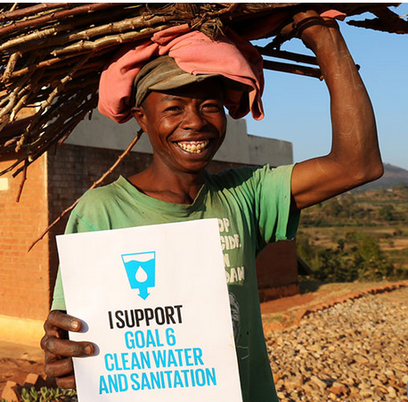
Thank you

Slide 35
Questions ??

